Slide 1



THINKSMARTER
2024

Slide 2

Government Polytechnic , Chh. Sambhajinagar
Department of Information Technology
ThinkSmarter :“Your Gateway To Integrated Intelligence”
Presented By :
1.Akshay Vinod Jha
2.Aditya Somnath Vyavhare
3.Tanmay Bharat Satalkar
4.Sujit Shankar Kolte
5.Siddhi Suhas Nagapure

Slide 3
Project-Objective :
1
1. Focus on catering to the needs of students by designing the project.
2. Offer free services accessible to all individuals.
3. Address and resolve challenges faced by students.
4. Strive to optimize and save students' valuable time.
5. Implement a user-friendly interface.
6. Establish an efficient study methodology to enhance the learning experience for students.
2
3
4
5
6
7
8
9

Slide 4



Technology Stack
Front – end :
1
2
3
4
React is a JavaScript library used for building user interfaces (UIs), particularly for web applications. Developed by Facebook, React allows developers to create reusable UI components that can efficiently update and render in response to changes in data. React uses a declarative approach, where developers describe how the UI should look based on the current application state, and React takes care of efficiently updating the DOM to match this desired state.
JavaScript is a high-level, interpreted scripting language that allows developers to add interactive and dynamic features to websites. It is widely supported by web browsers and can be used for a variety of purposes, including creating interactive user interfaces, implementing client-side logic, handling events, and communicating with servers. JavaScript is an essential technology for modern web development and is often used in conjunction with HTML and CSS to build engaging and interactive web applications.
Redux is a predictable state container for JavaScript apps, commonly used with React, managing app state in a single, immutable tree. It ensures consistent behavior across environments with a strict unidirectional data flow. Redux offers a centralized store for state, with changes made by dispatching actions. Reducer functions handle these actions to update the state. Redux facilitates managing complex app states, debugging, and implementing features like time-travel debugging and state persistence.
5
6
7
8
9

Slide 5



1
2
Sass, which stands for "Syntactically Awesome Style Sheets," is a preprocessor scripting language that is interpreted or compiled into Cascading Style Sheets (CSS). It extends the functionality of CSS by providing features like variables, nesting, mixins, inheritance, and more. Sass helps developers write cleaner, more maintainable CSS code by allowing them to organize stylesheets more effectively and reduce repetition.
Tailwind CSS is a utility-first CSS framework that offers low-level utility classes for quickly building custom designs. Unlike traditional frameworks, it emphasizes utility classes for styles like margins, padding, and colors, allowing developers to create custom designs directly in HTML templates without writing custom CSS. Tailwind CSS supports a "design in the browser" approach, facilitating rapid prototyping and iteration. Its highly customizable and scalable nature makes it popular among developers for efficiently styling web applications.
3
Framer Motion is a JavaScript library for React that simplifies creating animations and gestures in web applications. With an intuitive API, it supports various animation features like keyframes and spring physics, seamlessly integrating with React components. Known for its performance and ease of use, Framer Motion is favored for building dynamic and engaging user interfaces in React.
4
5
6
7
8
9

Slide 6
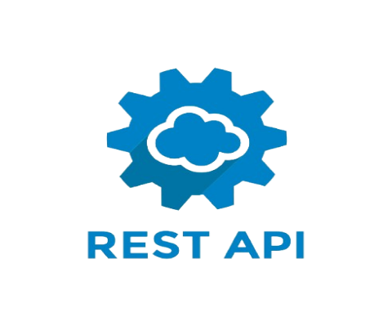


SERVICES :
1
2
3
Firebase, developed by Google, offers a range of tools and services for mobile and web app development, including real-time database, authentication, cloud storage, hosting, and analytics. It streamlines tasks like user authentication and data storage, freeing developers to concentrate on creating engaging user experiences. With its scalable services, Firebase is a popular choice for developers seeking to build, enhance, and expand their applications efficiently.
An API, or Application Programming Interface, enables software applications to communicate by defining rules and protocols for exchanging information. It allows access to data or functionality from external services, libraries, or frameworks, facilitating the integration of third-party services and the creation of scalable applications. APIs come in various forms, such as web APIs (HTTP communication), libraries (specific tasks), and operating system APIs (system resources). They are essential for modern software development, enabling interoperability between systems and simplifying the creation of complex applications.
4
React Icons which is a popular library for using icons in React applications. React Icons provides a collection of customizable, scalable icons from popular icon libraries like Font Awesome, Material Icons, and many others, allowing developers to easily add icons to their React projects without the need for additional dependencies. This library simplifies the process of integrating icons into React components, making UI development more efficient and consistent.
5
6
7
8
9

Slide 7

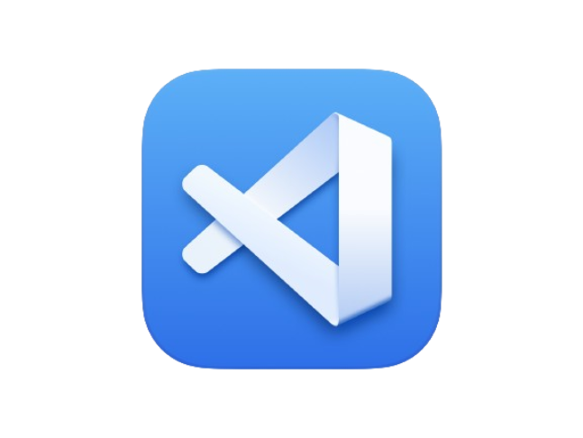
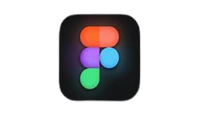
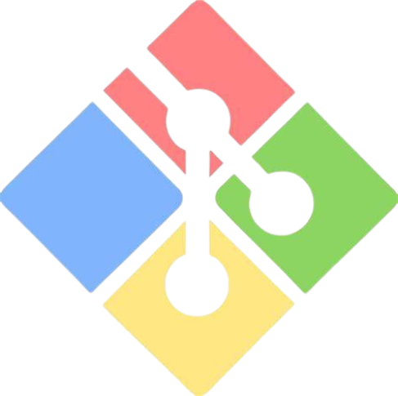
Design & Development :
1
GitHub is a web platform hosting Git repositories, aiding collaboration with features like pull requests and issue tracking. It's a hub for developers to manage projects, showcase work, and contribute to open-source projects.
2
3
4
5
VS Code, or Visual Studio Code, is a free source-code editor by Microsoft, supporting multiple languages and customizable with extensions. It's favored by developers for its features like syntax highlighting, debugging, and version control integration, along with a built-in terminal.
6
Figma is a web-based design tool for creating interfaces and prototypes collaboratively in real-time. It's favored by UI/UX designers for its features like real-time collaboration, prototyping, and easy sharing, all stored securely in the cloud.
7
Git is a distributed version control system used for tracking changes in source code during software development. It allows multiple developers to collaborate on projects, keeping track of revisions, and managing codebase versions efficiently. Git is widely used in the software development industry due to its flexibility, speed, and robustness.
8
9

Slide 8
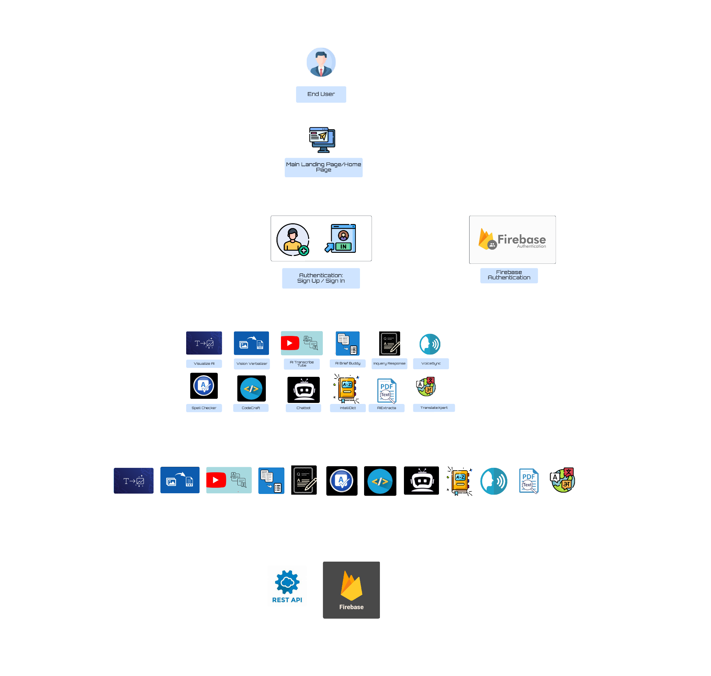
Workflow
1
2
3
ShoeStoppers :
Text to Image – Visualize AI
Image to text – Vision verbalizer
Chatbot – Chatbot
Dictionary – Intellidict
Context question answer – Inquery Response
Spell checker – Spell Checker
Summarizer – AI Brief Buddy
Text extraction – AIExtracta
Text to code – Code Craft
Text to speech – Text To Speech
Translation - TranslateXpert
Youtube transcribe – AI Transcribe Tube
4
Authentication
5
6
7
8
Request /
Response
History Management
9

Slide 9
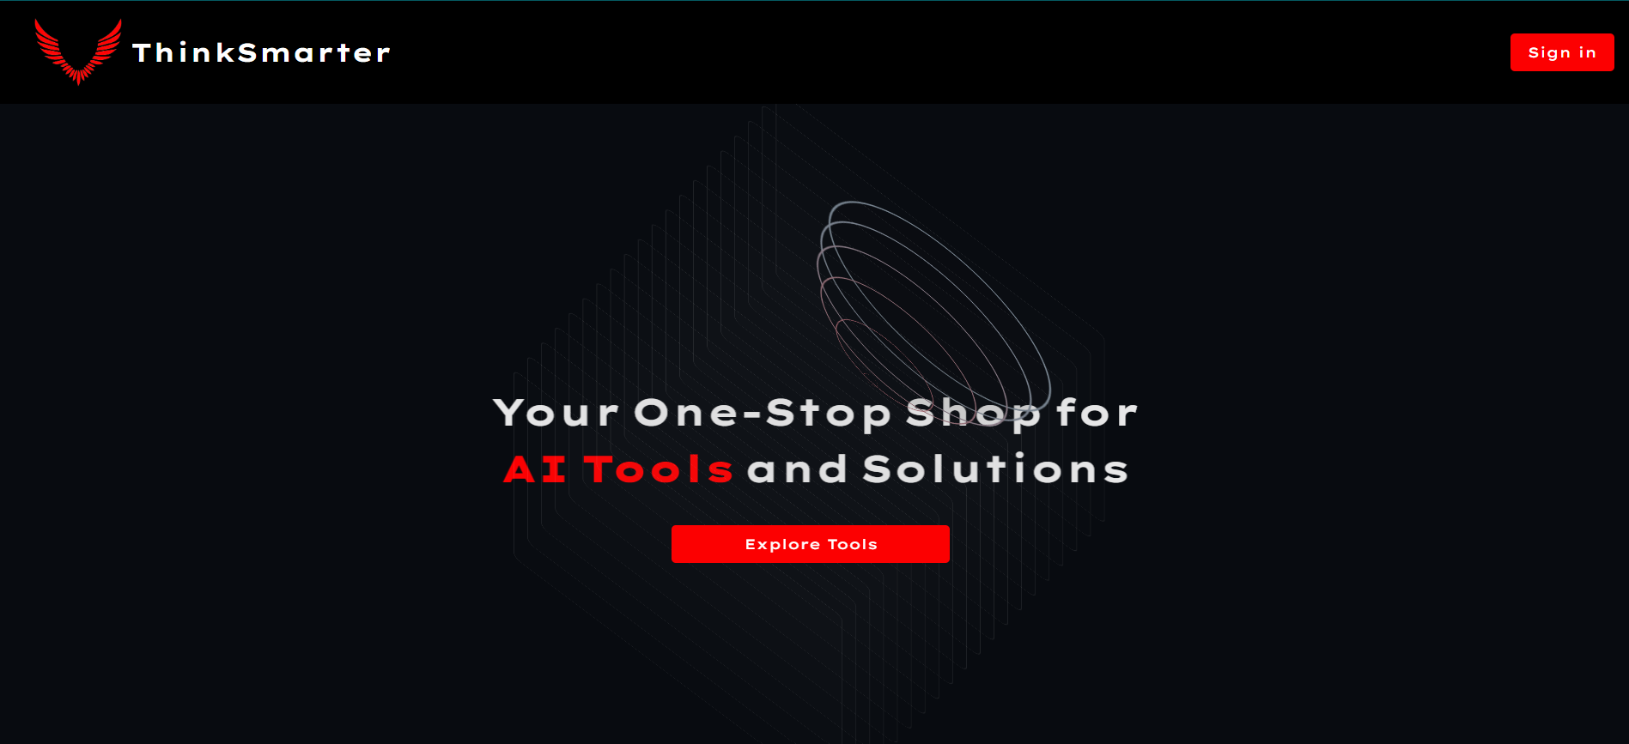
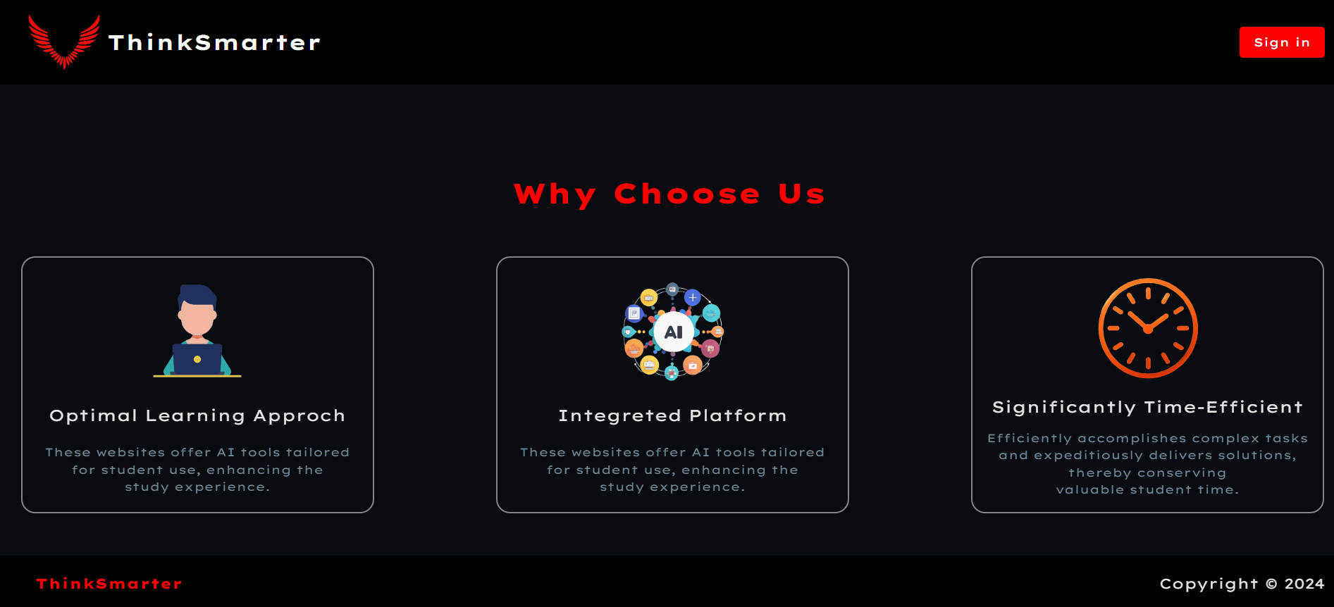
1
2
3
4
5
6
7
8
9

Slide 10
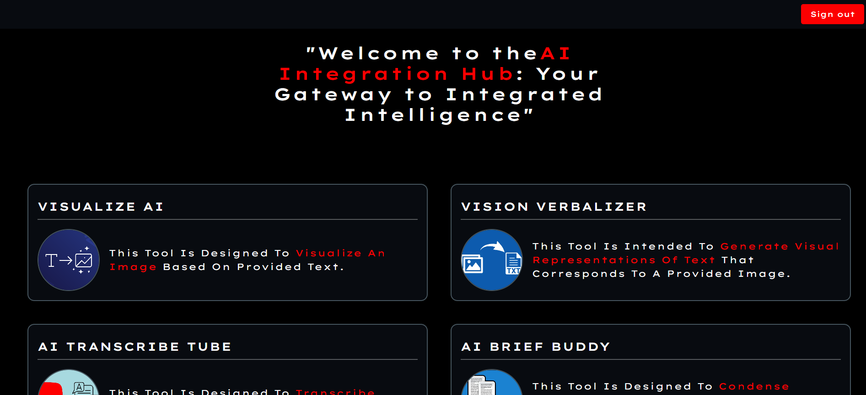
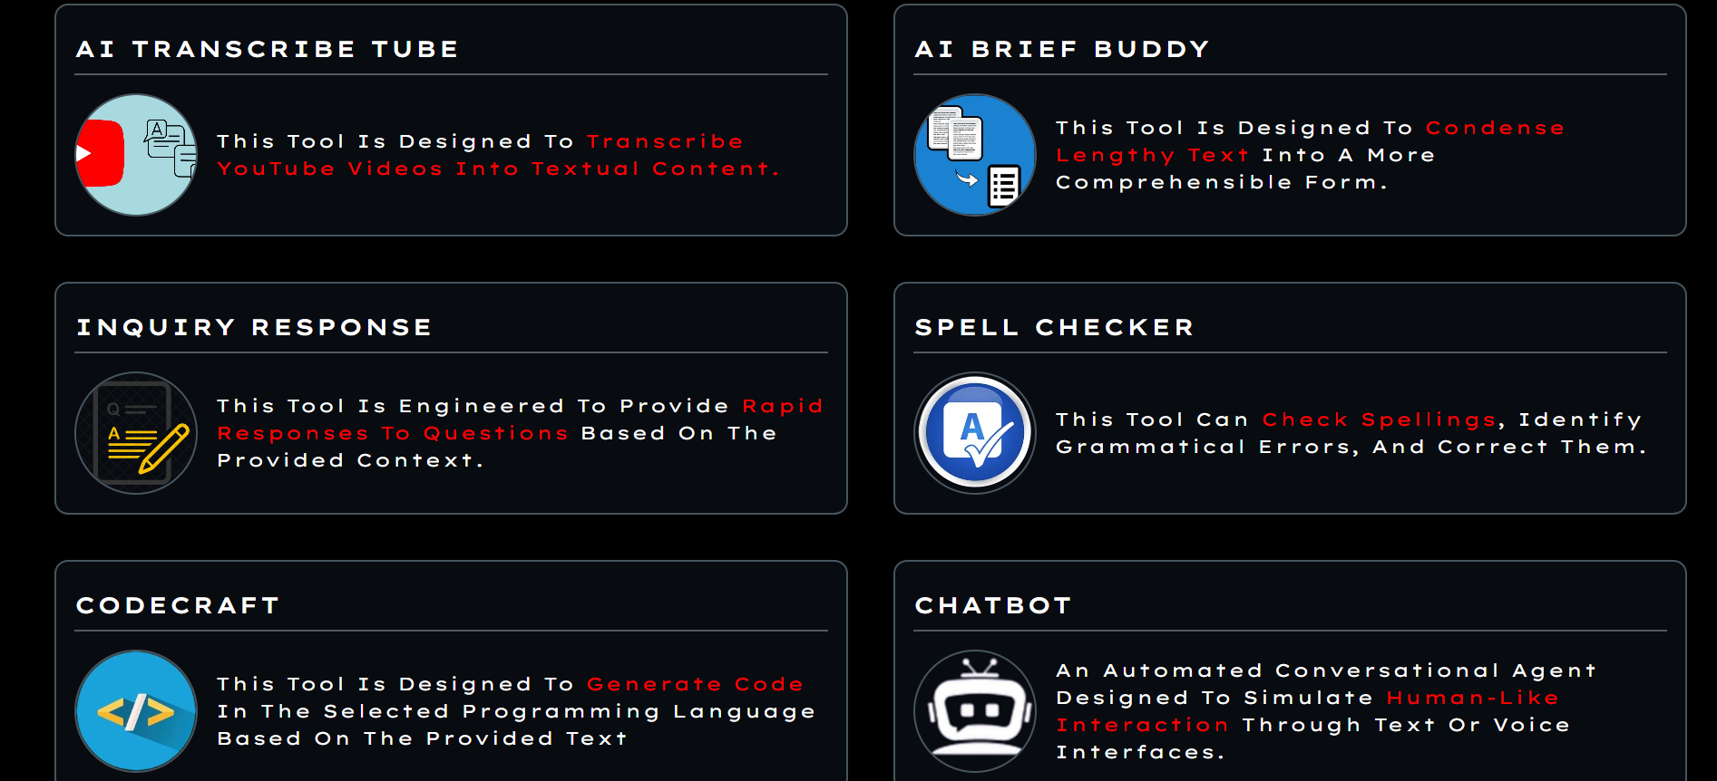
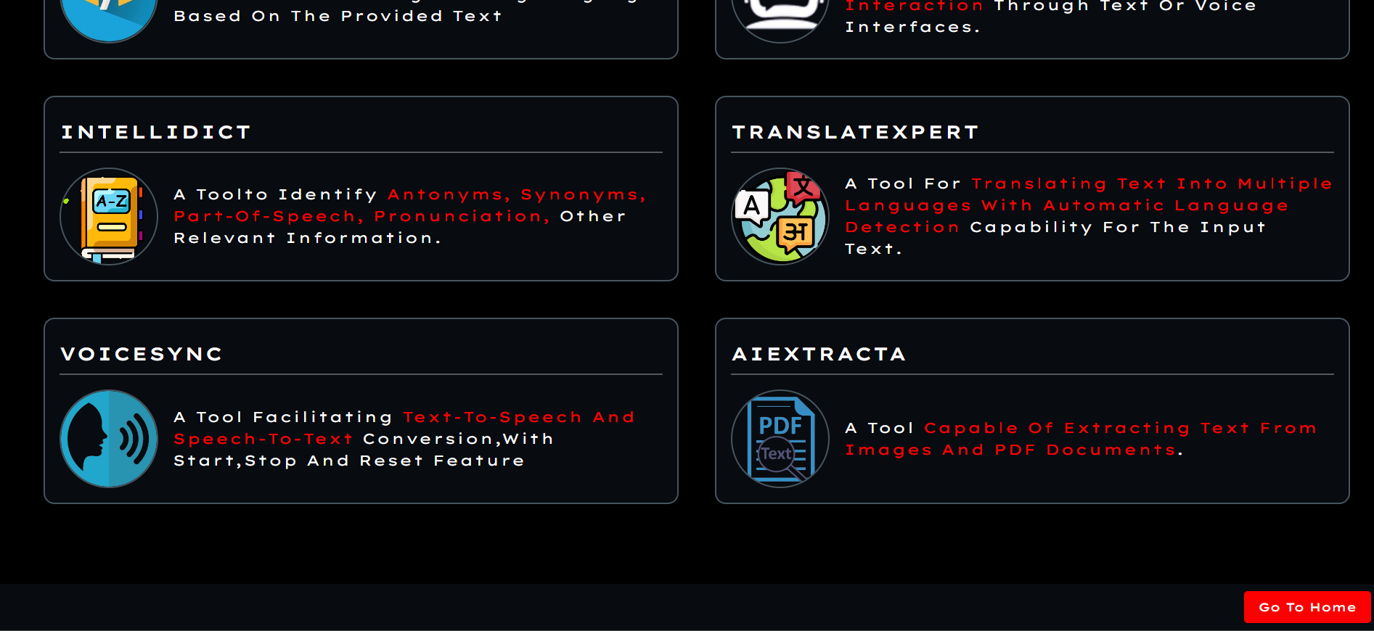
1
2
3
4
5
6
7
8
9

Slide 11
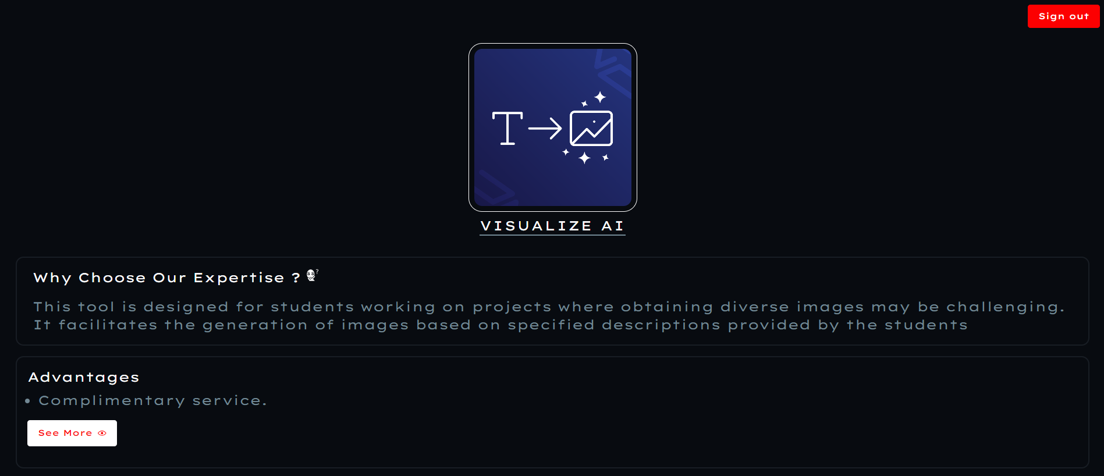
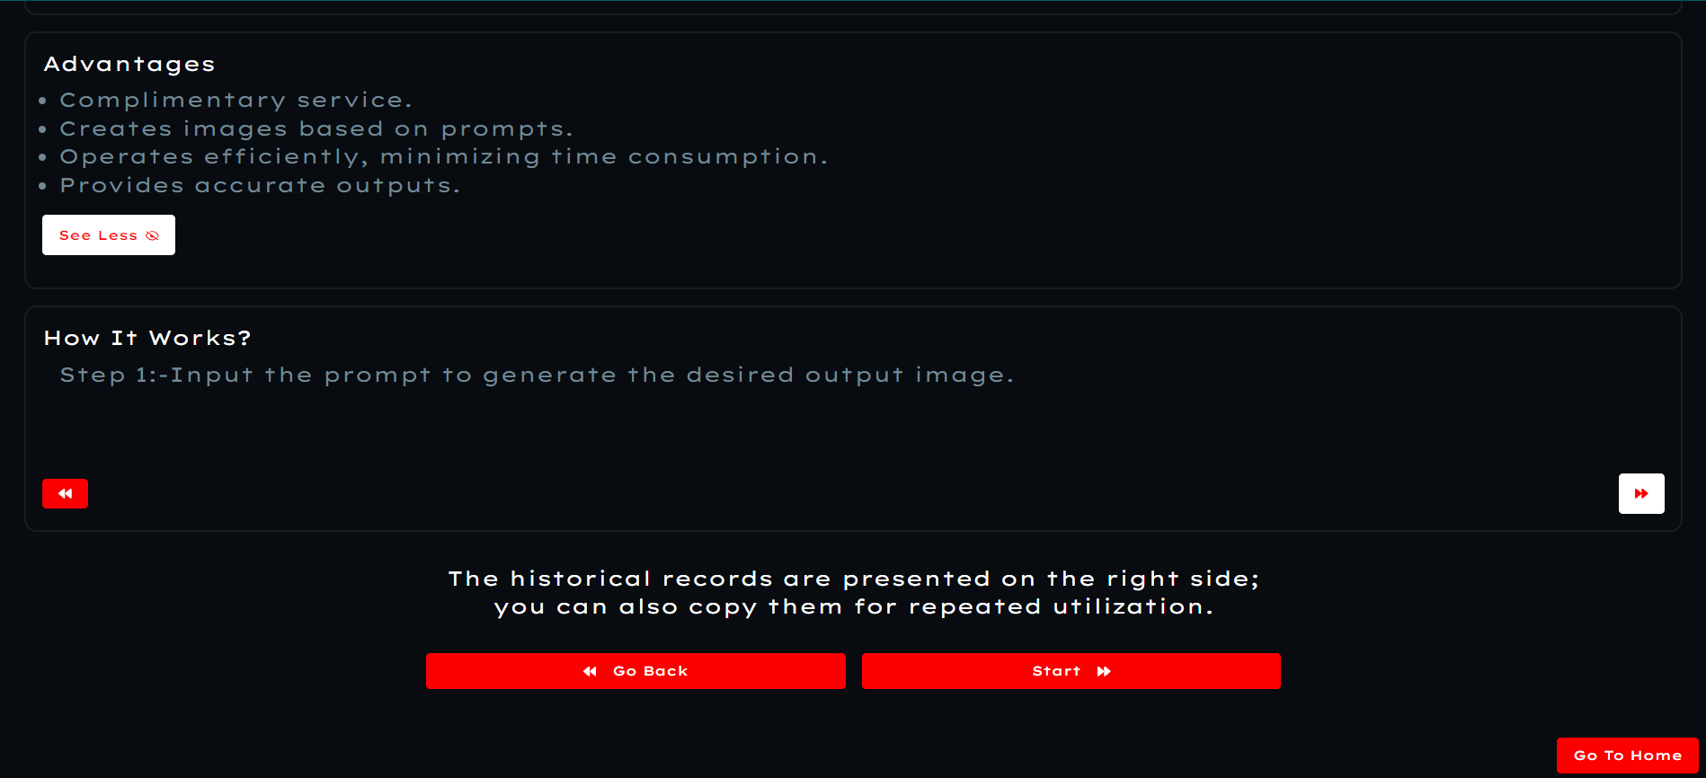
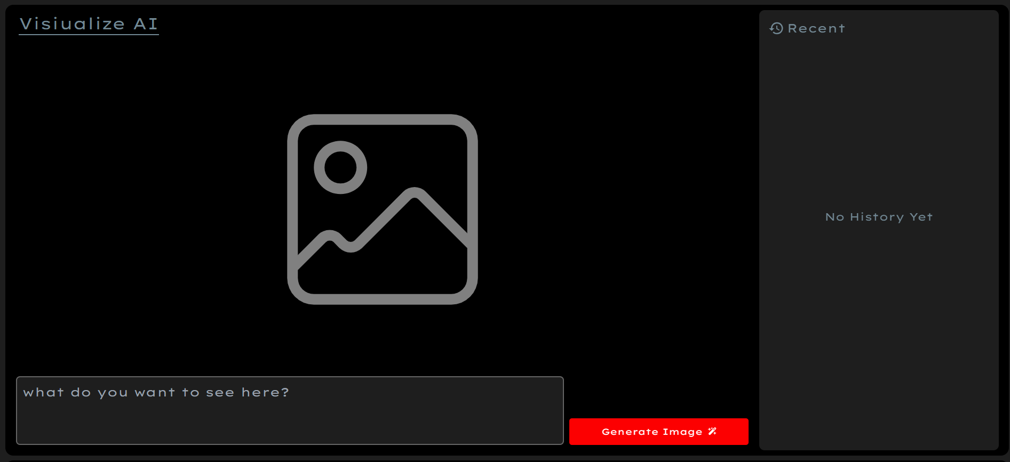
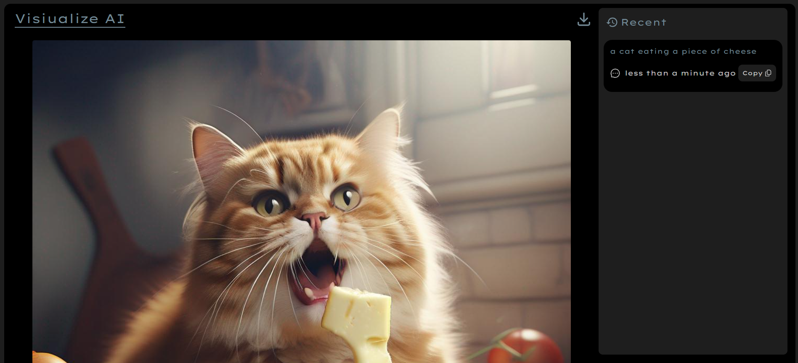
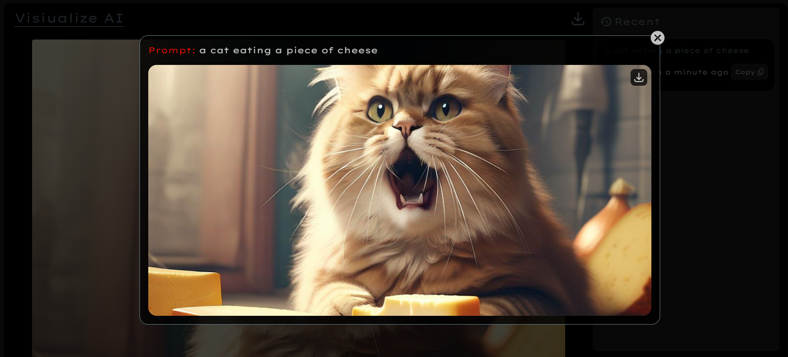
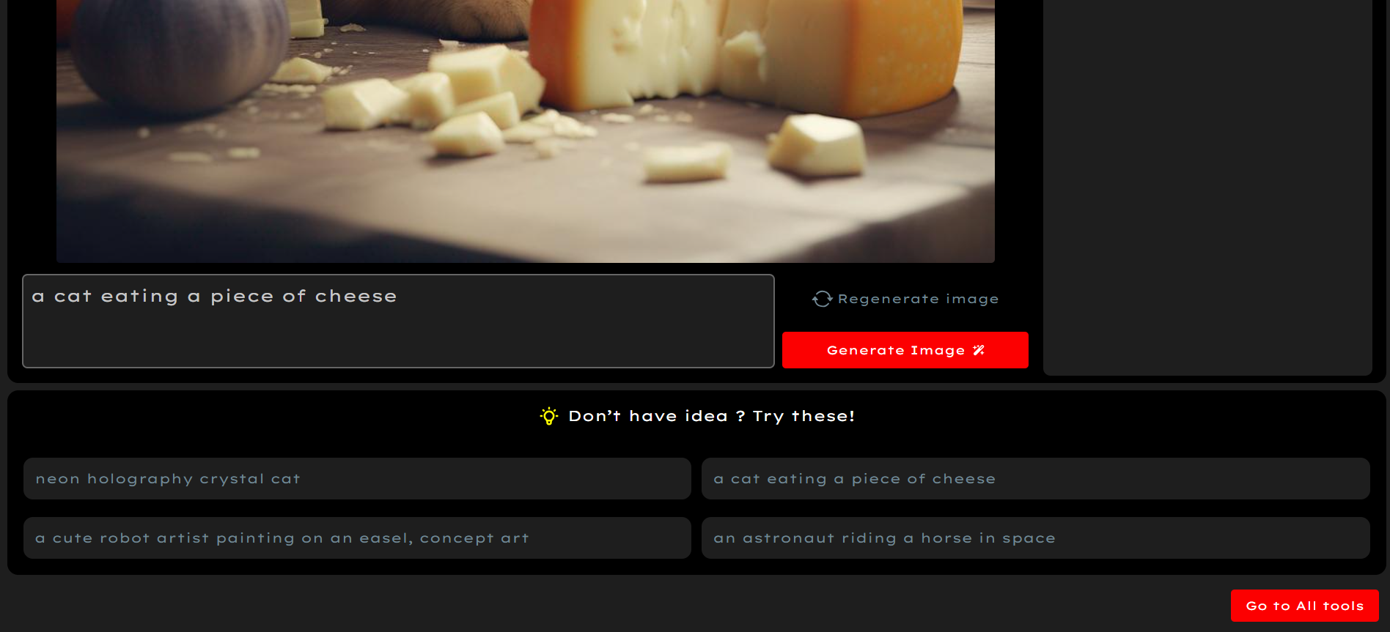

Slide 12
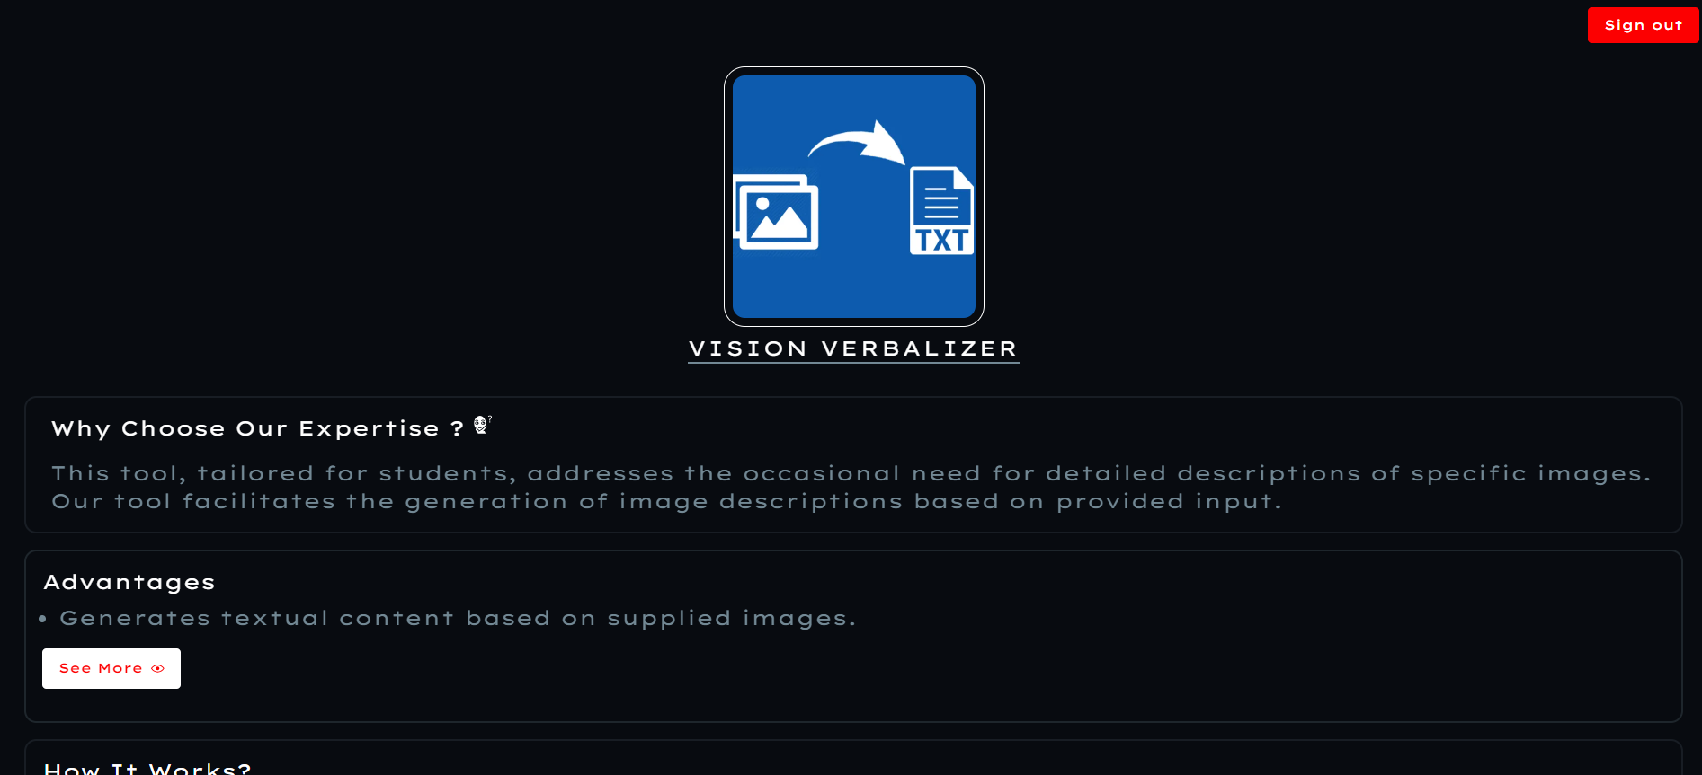
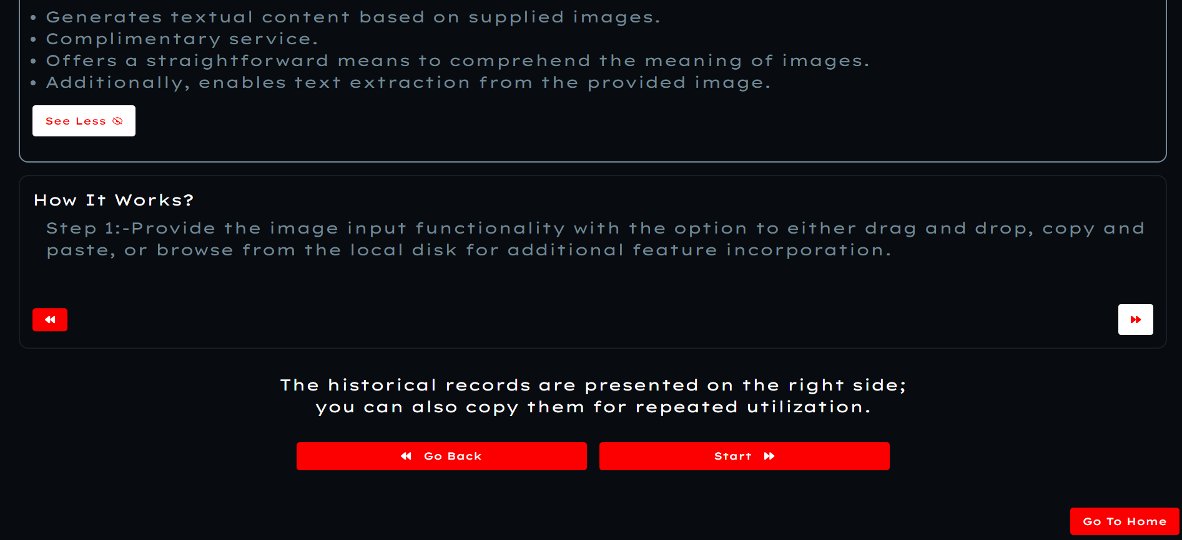
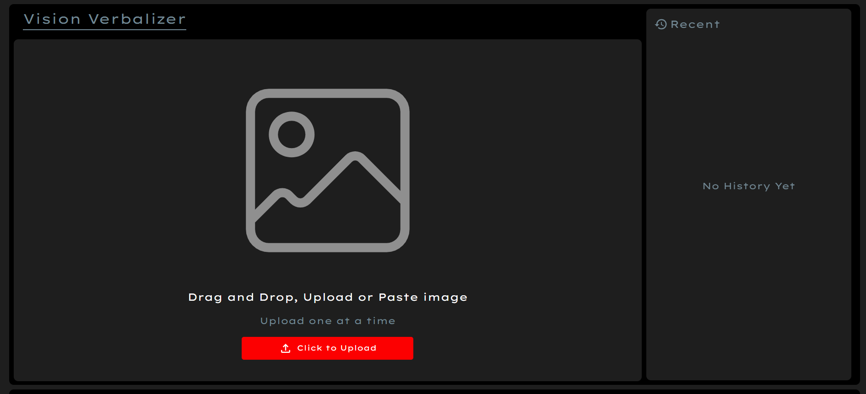
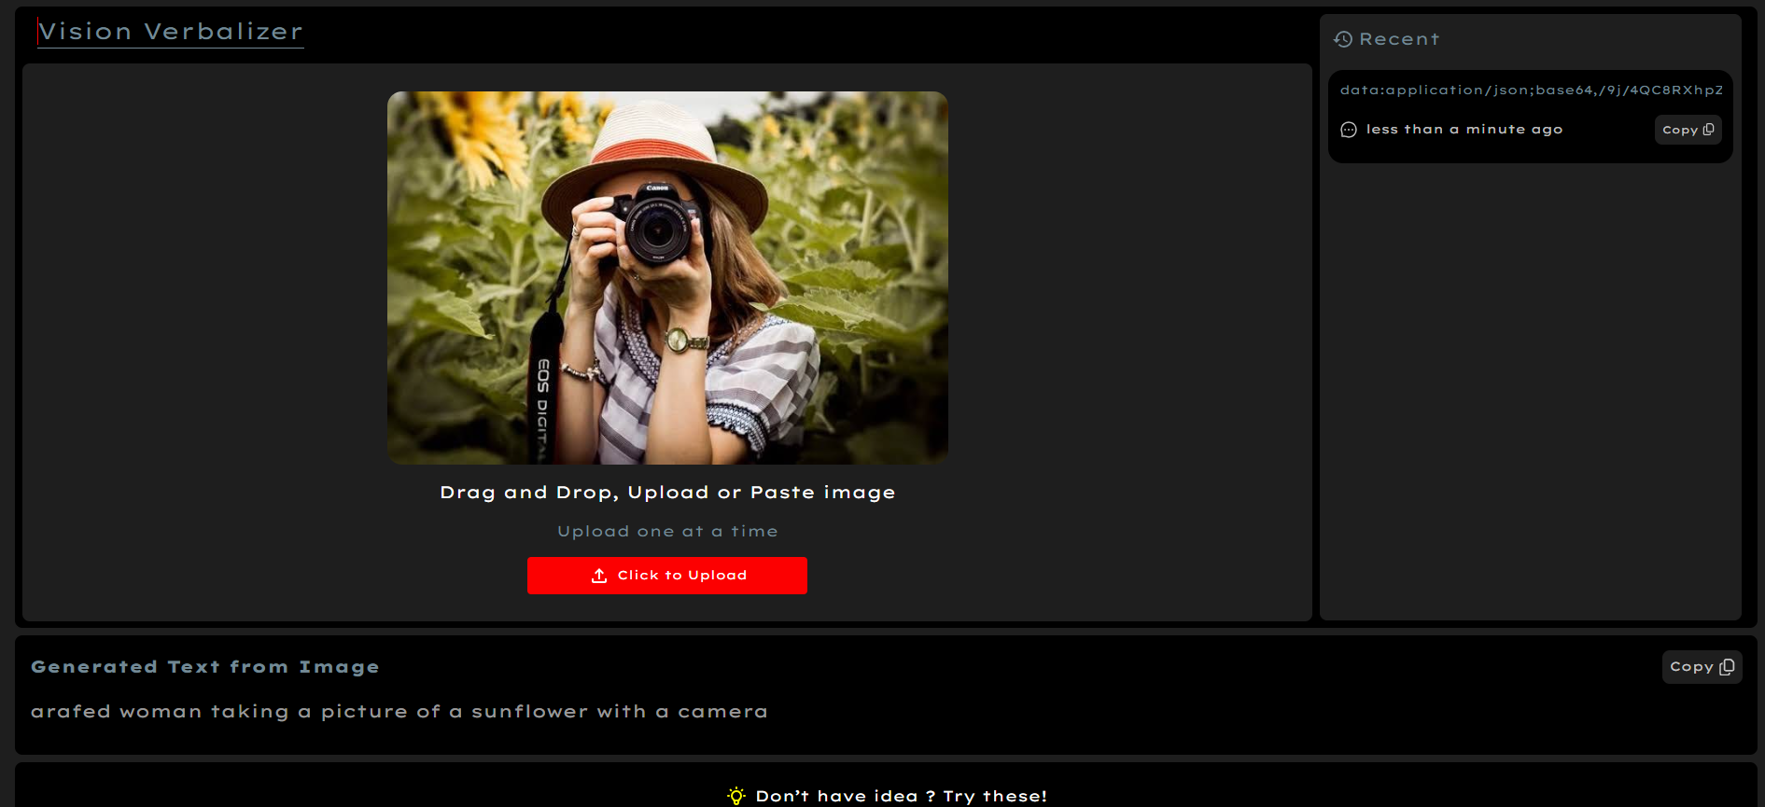
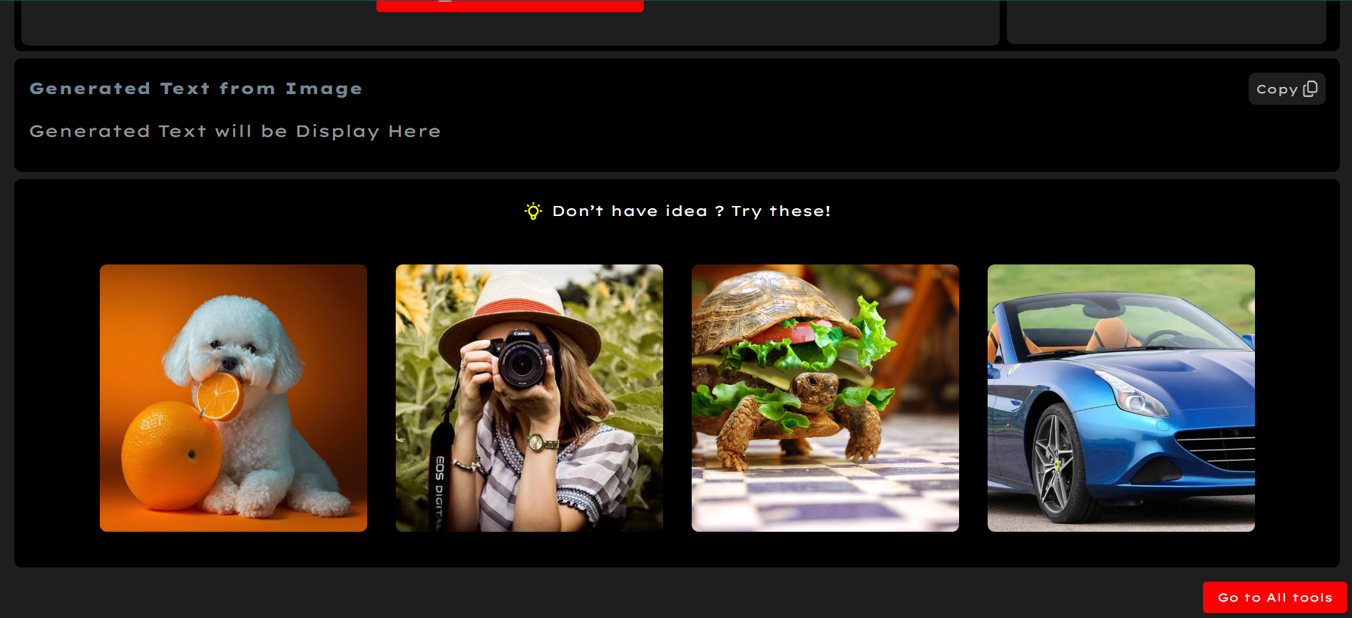


Slide 13
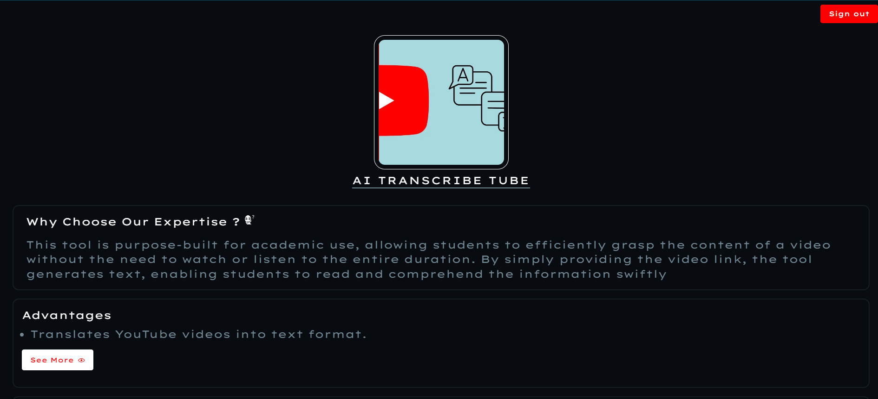

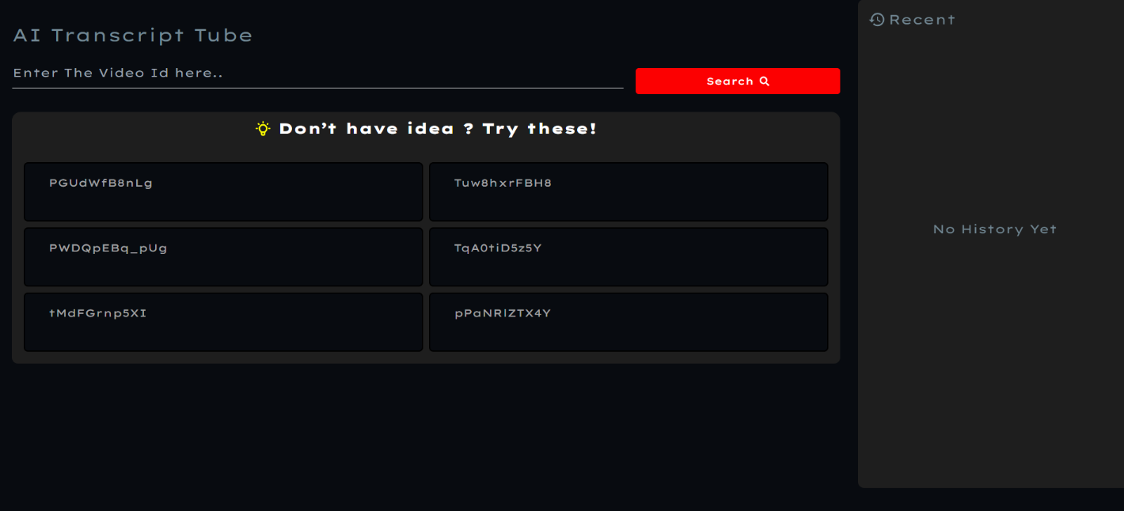
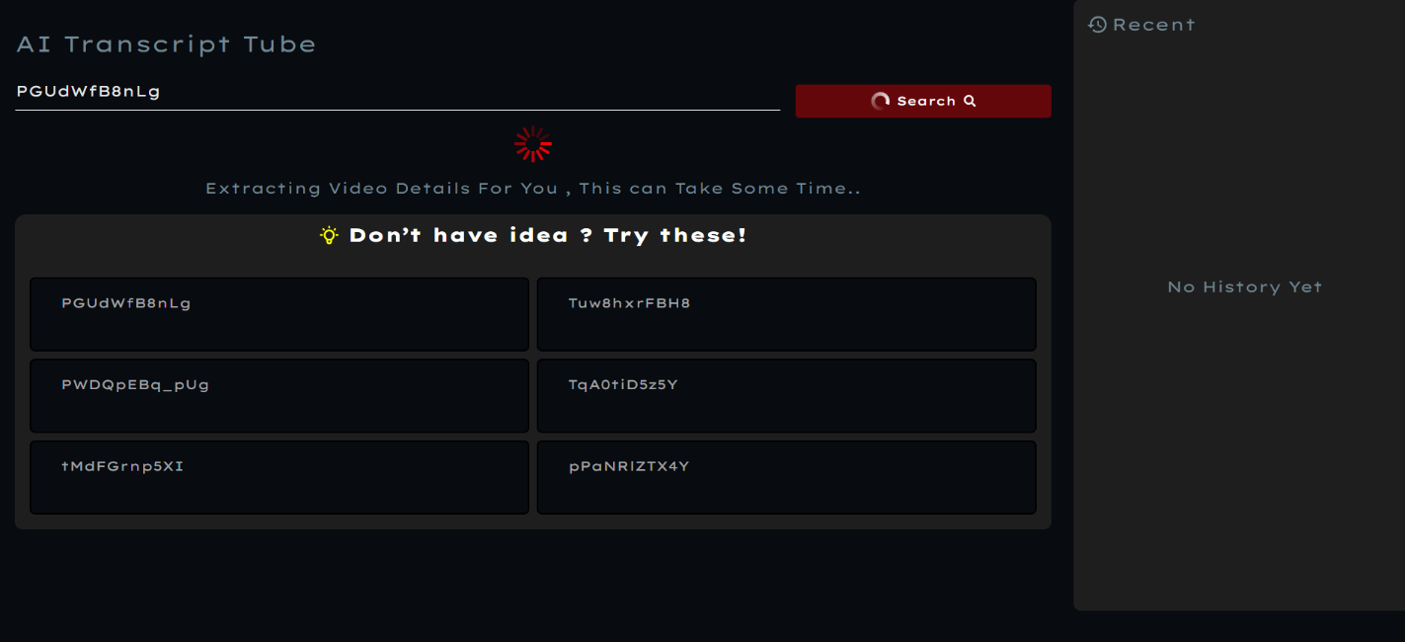
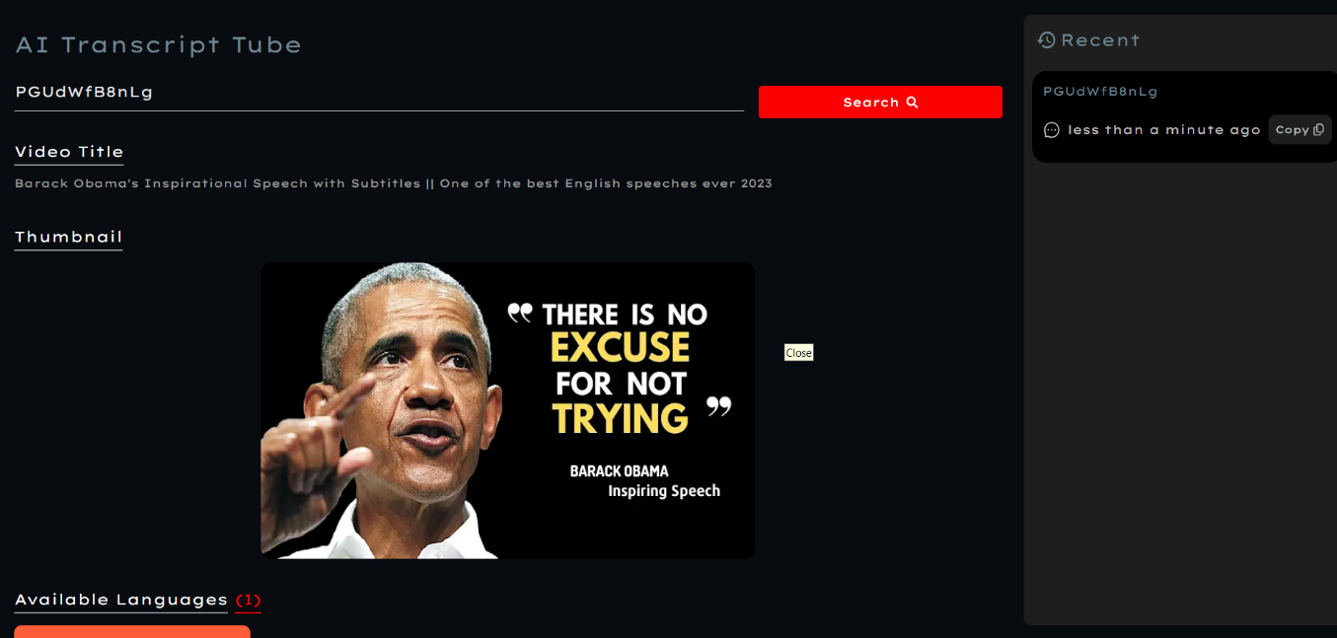
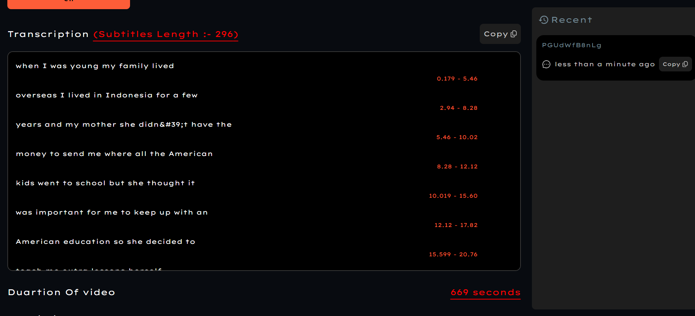
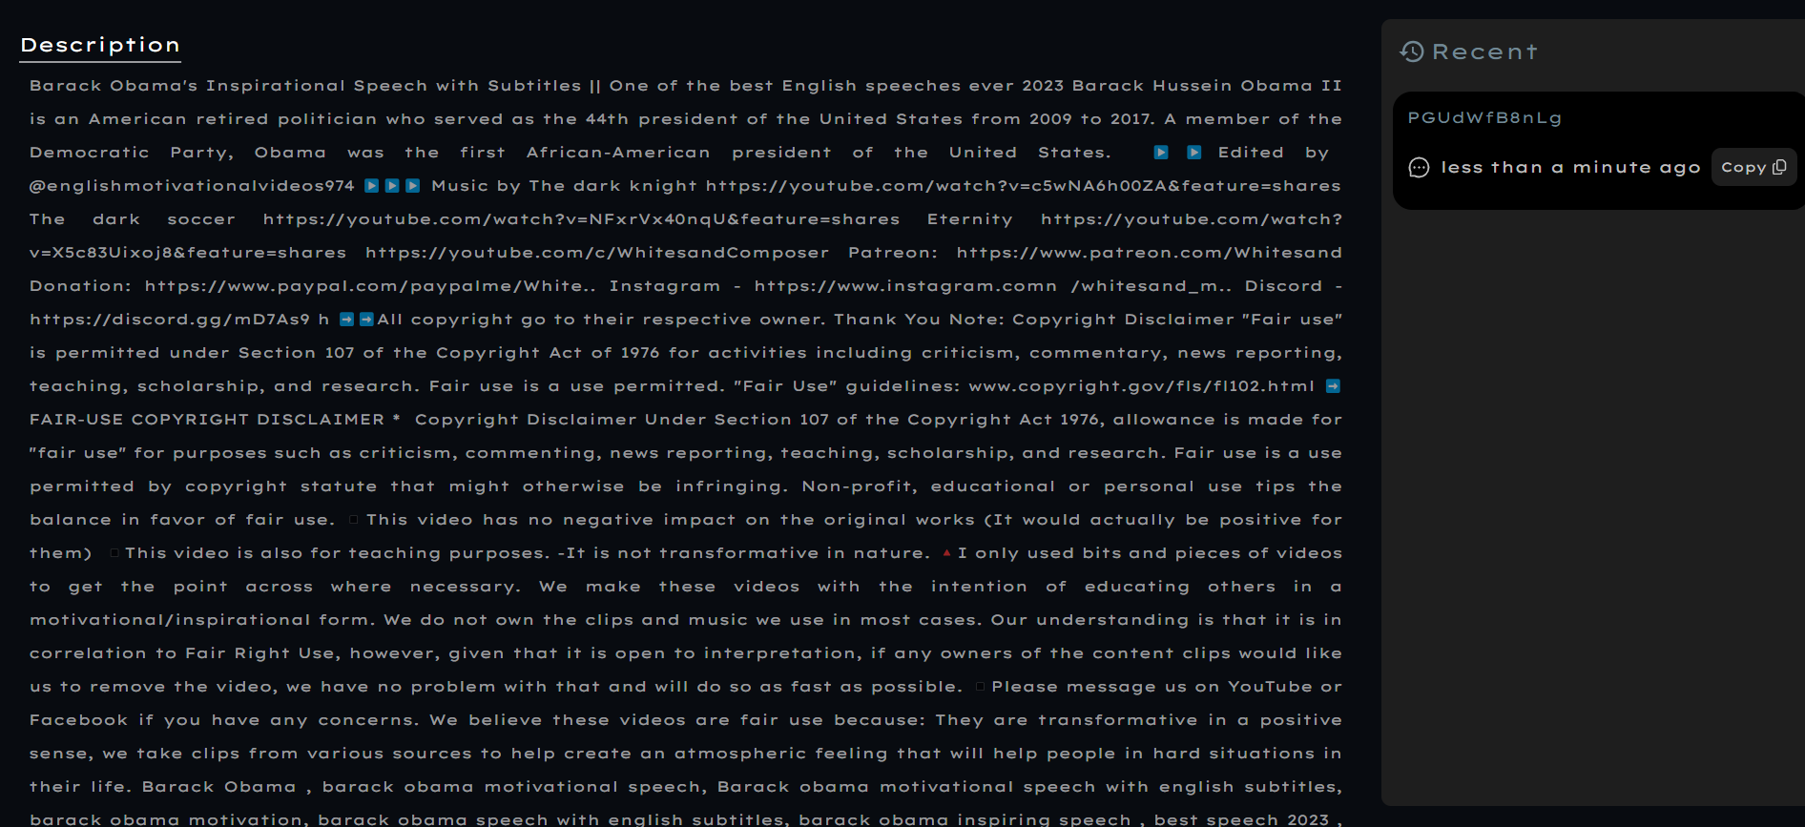
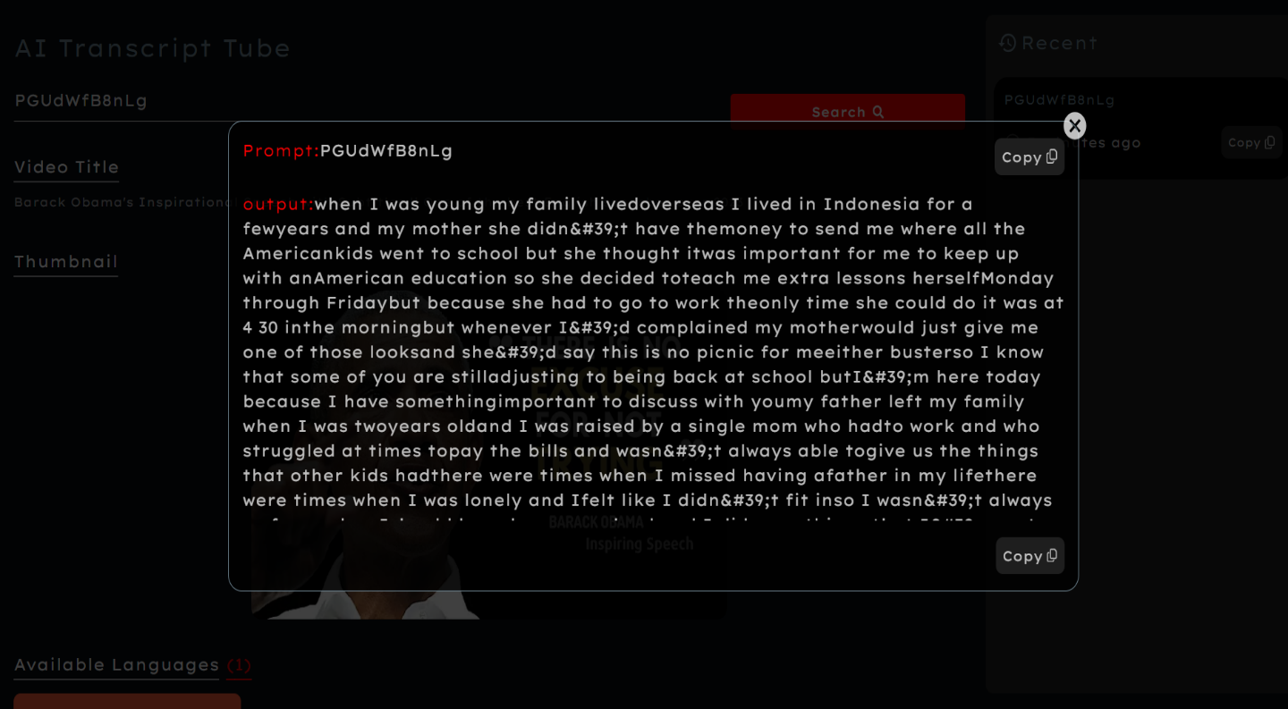

Slide 14
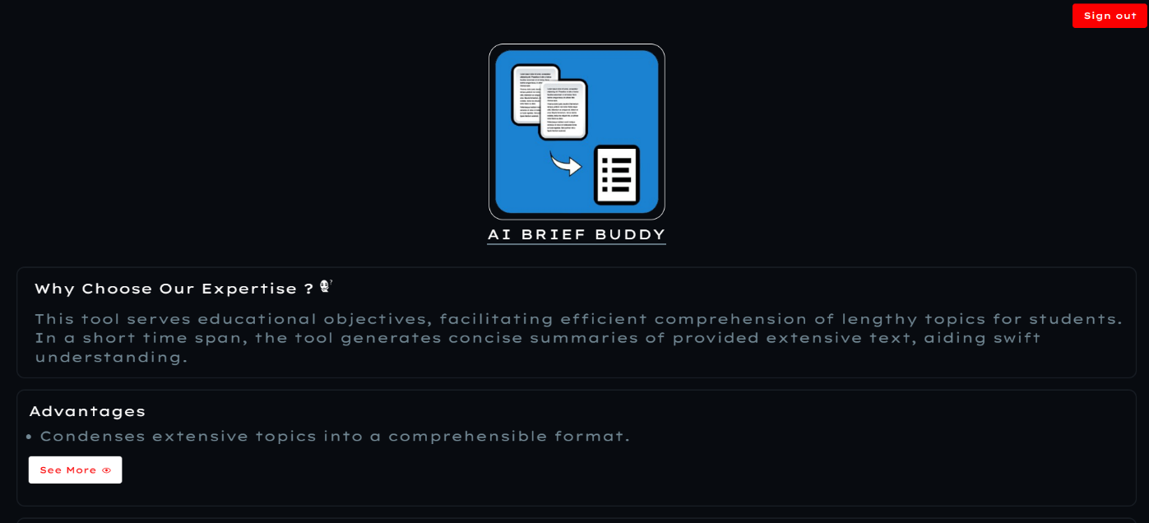
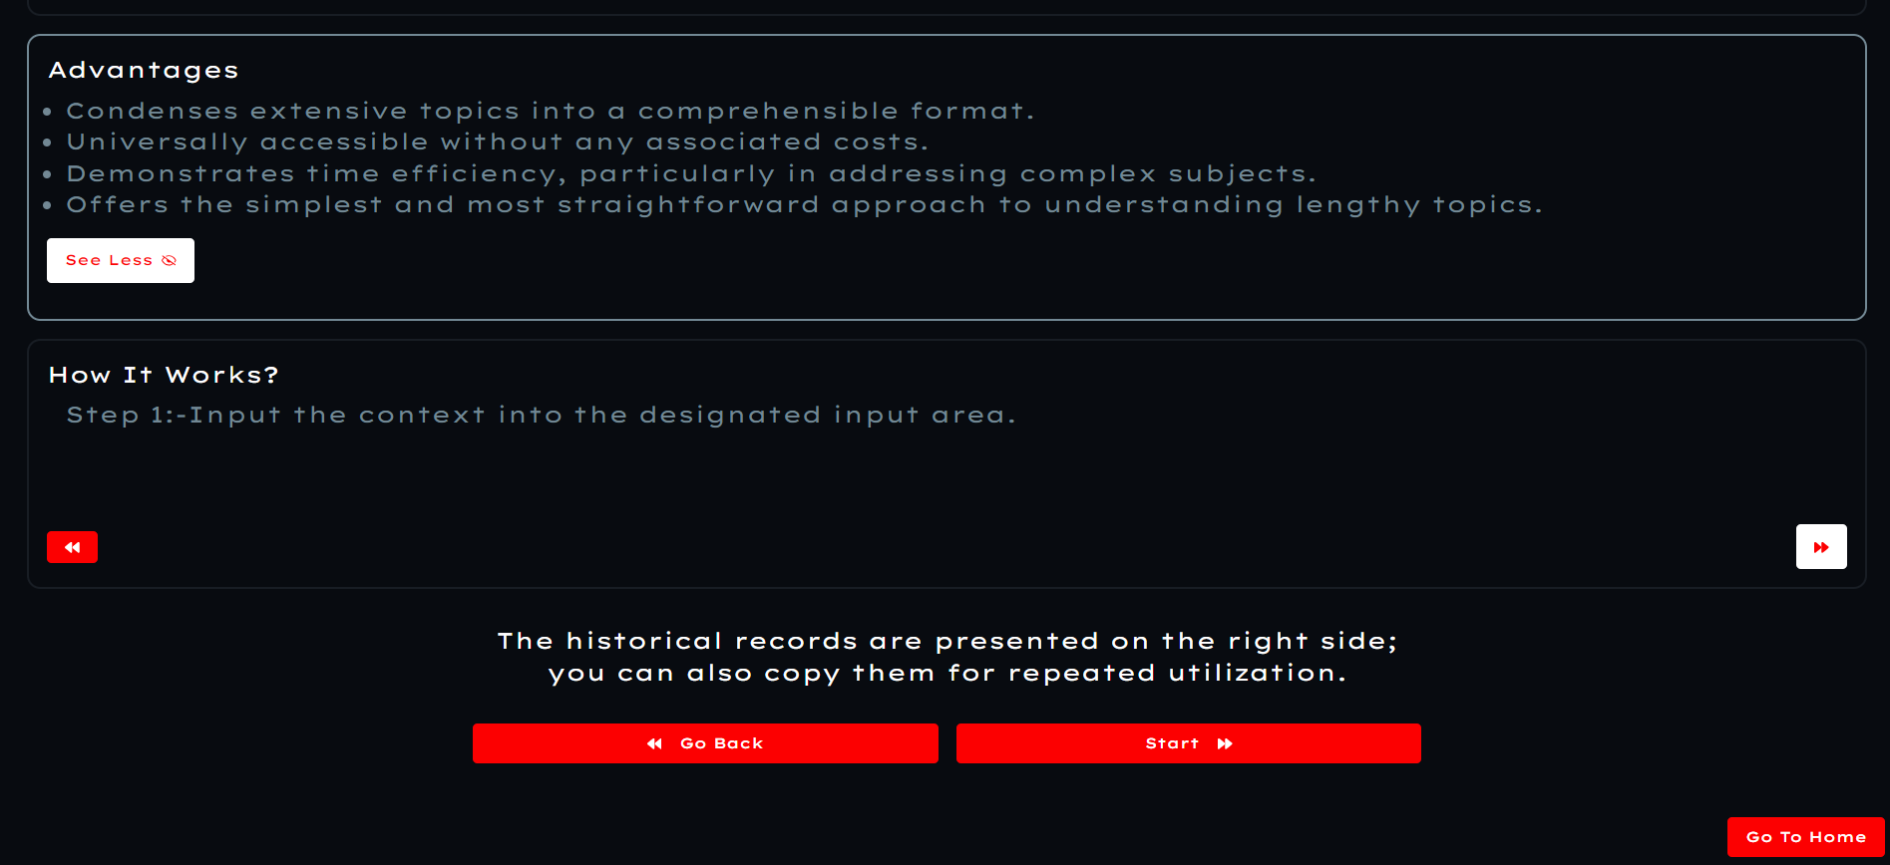
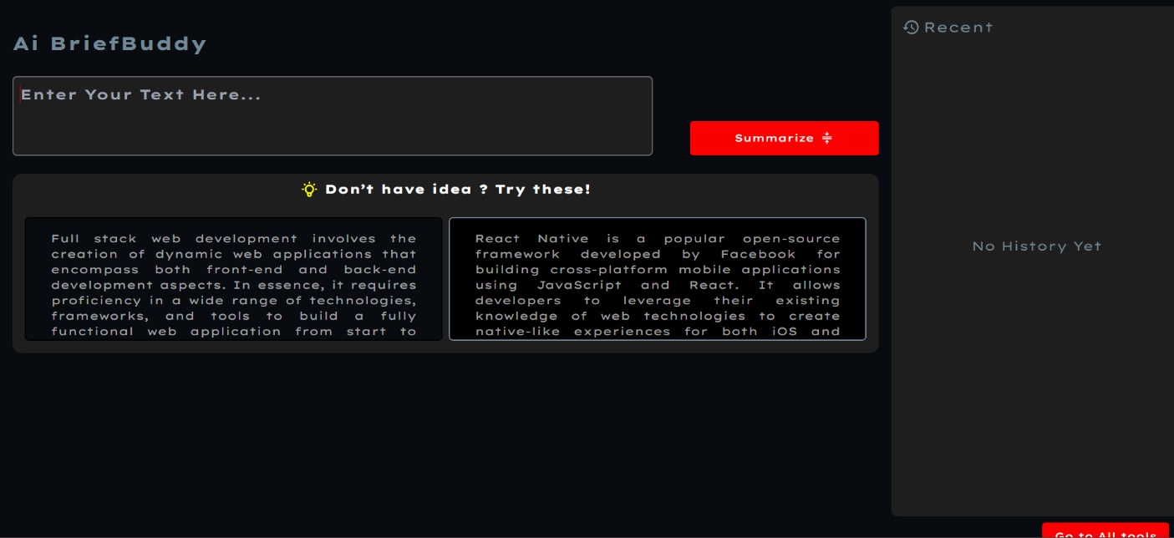
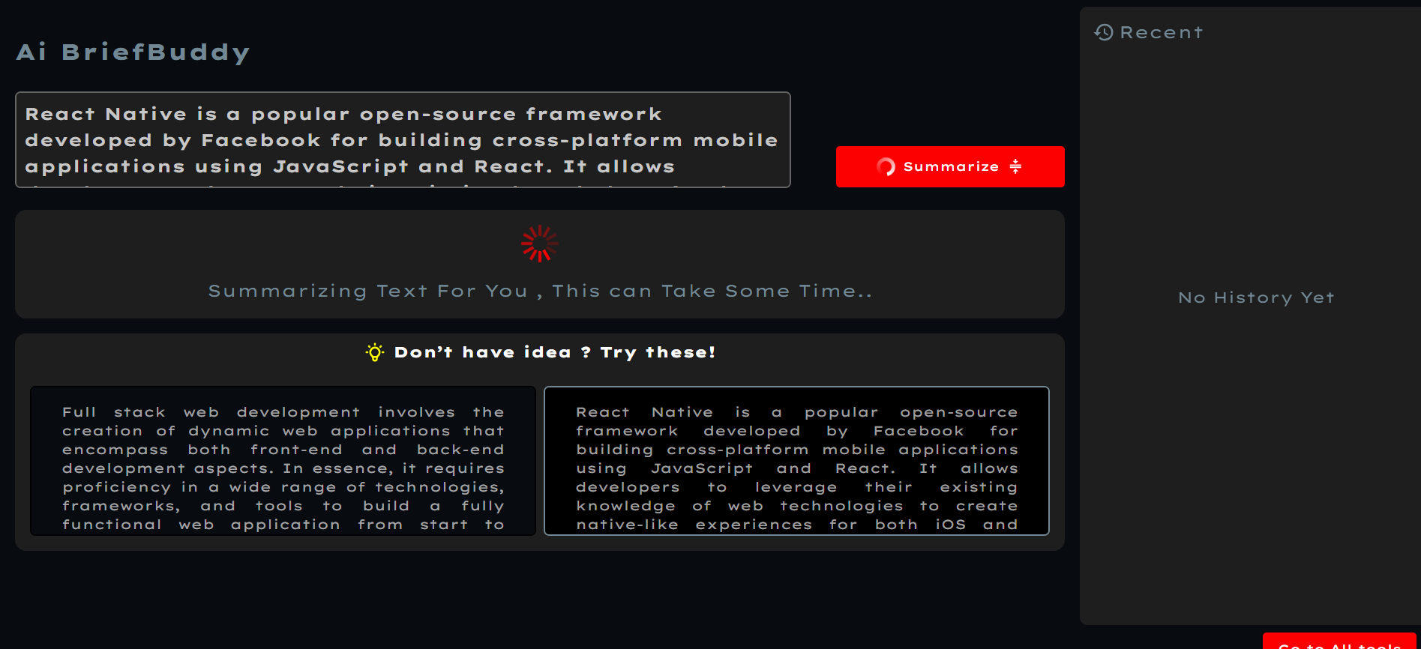
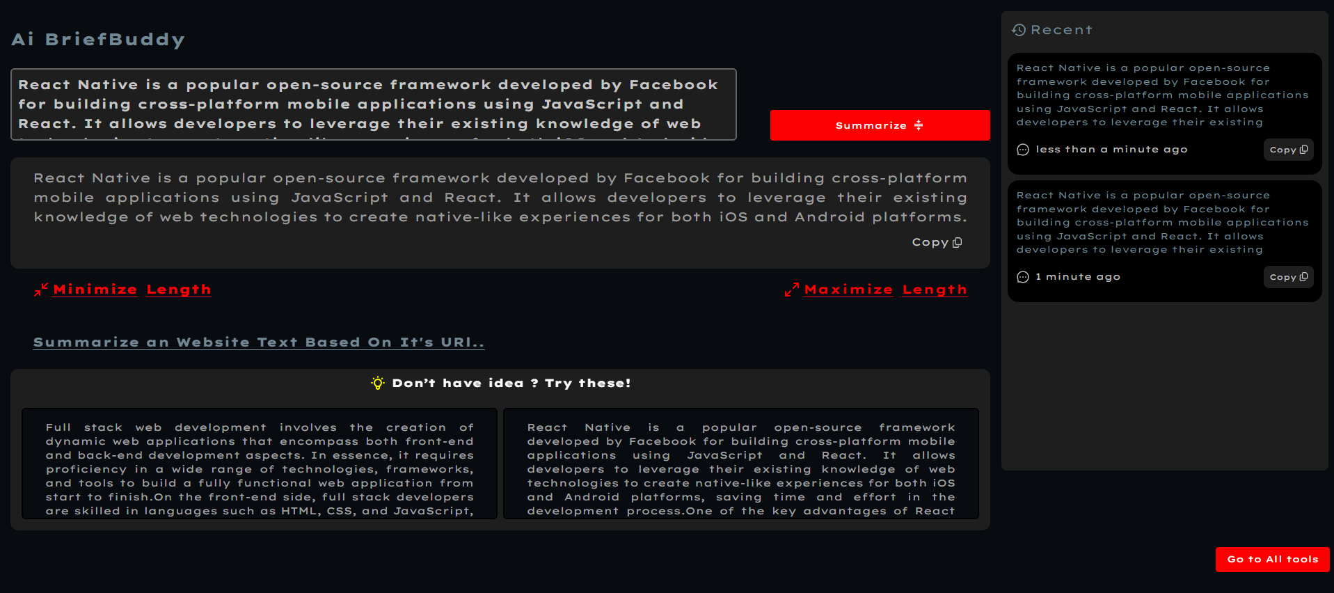
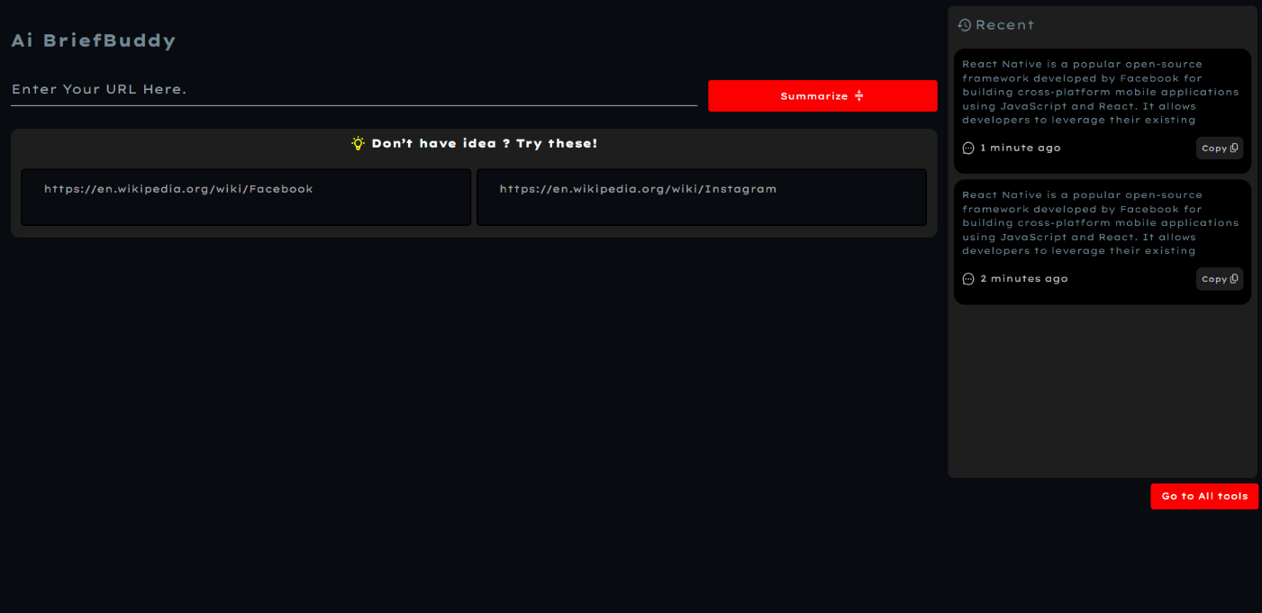
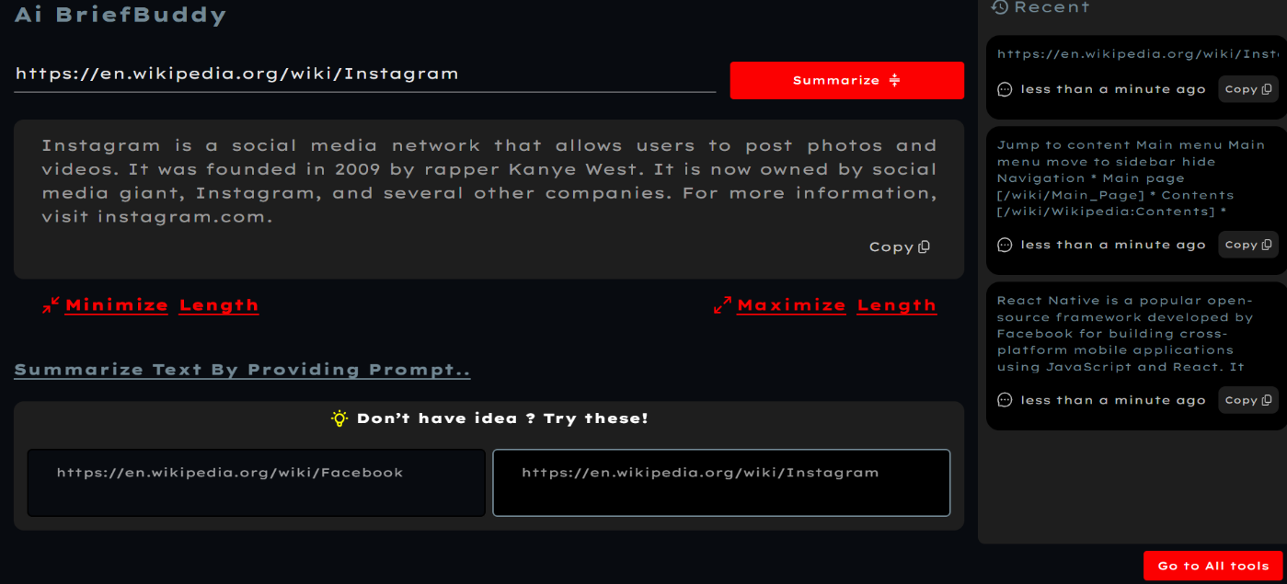
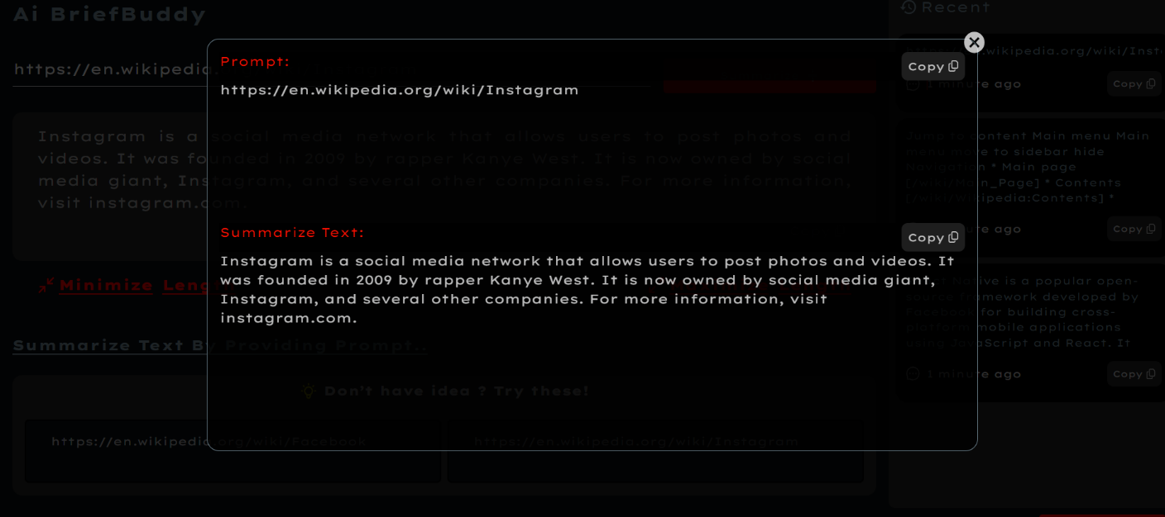

Slide 15
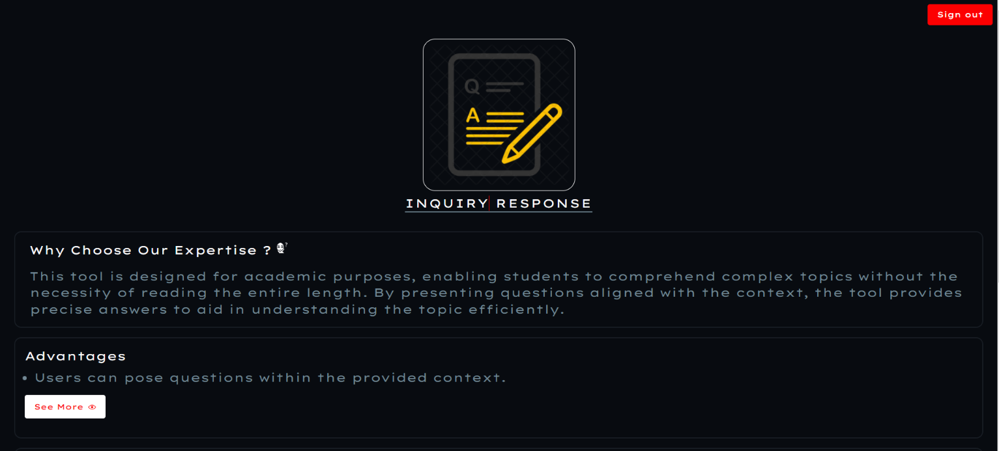

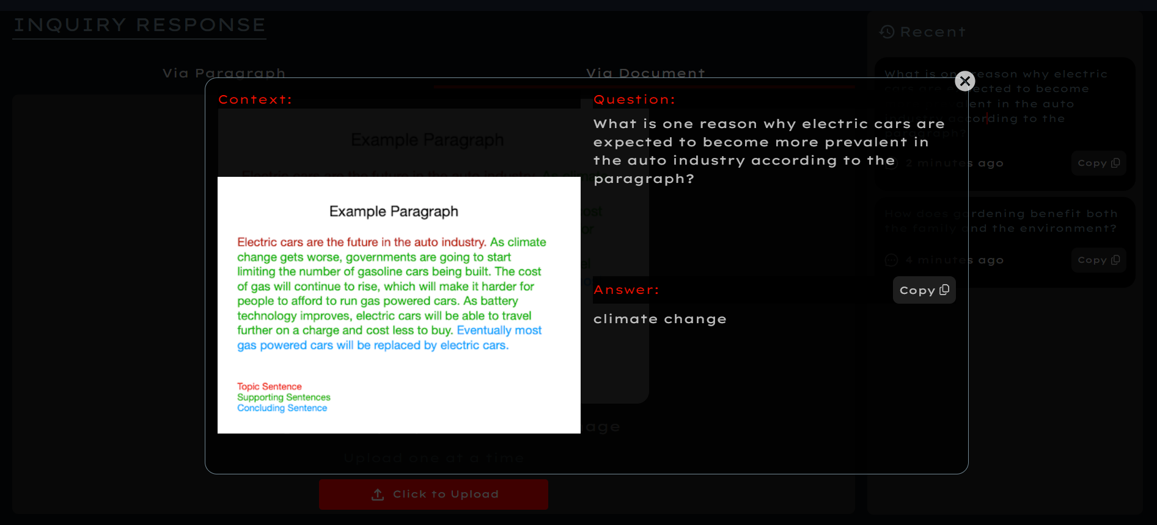
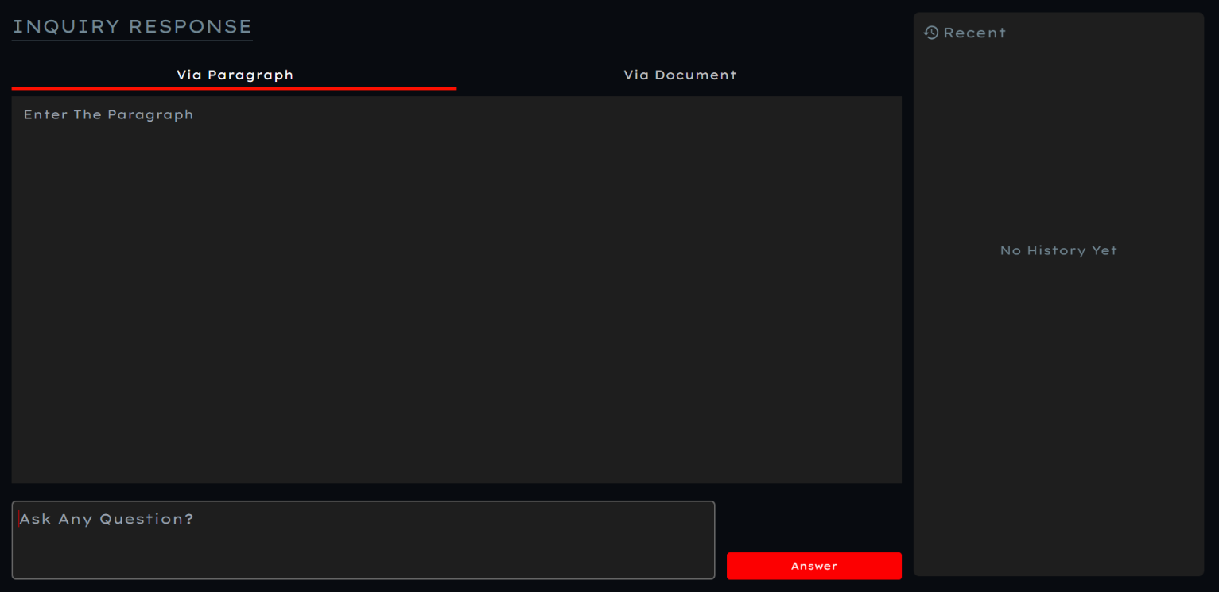
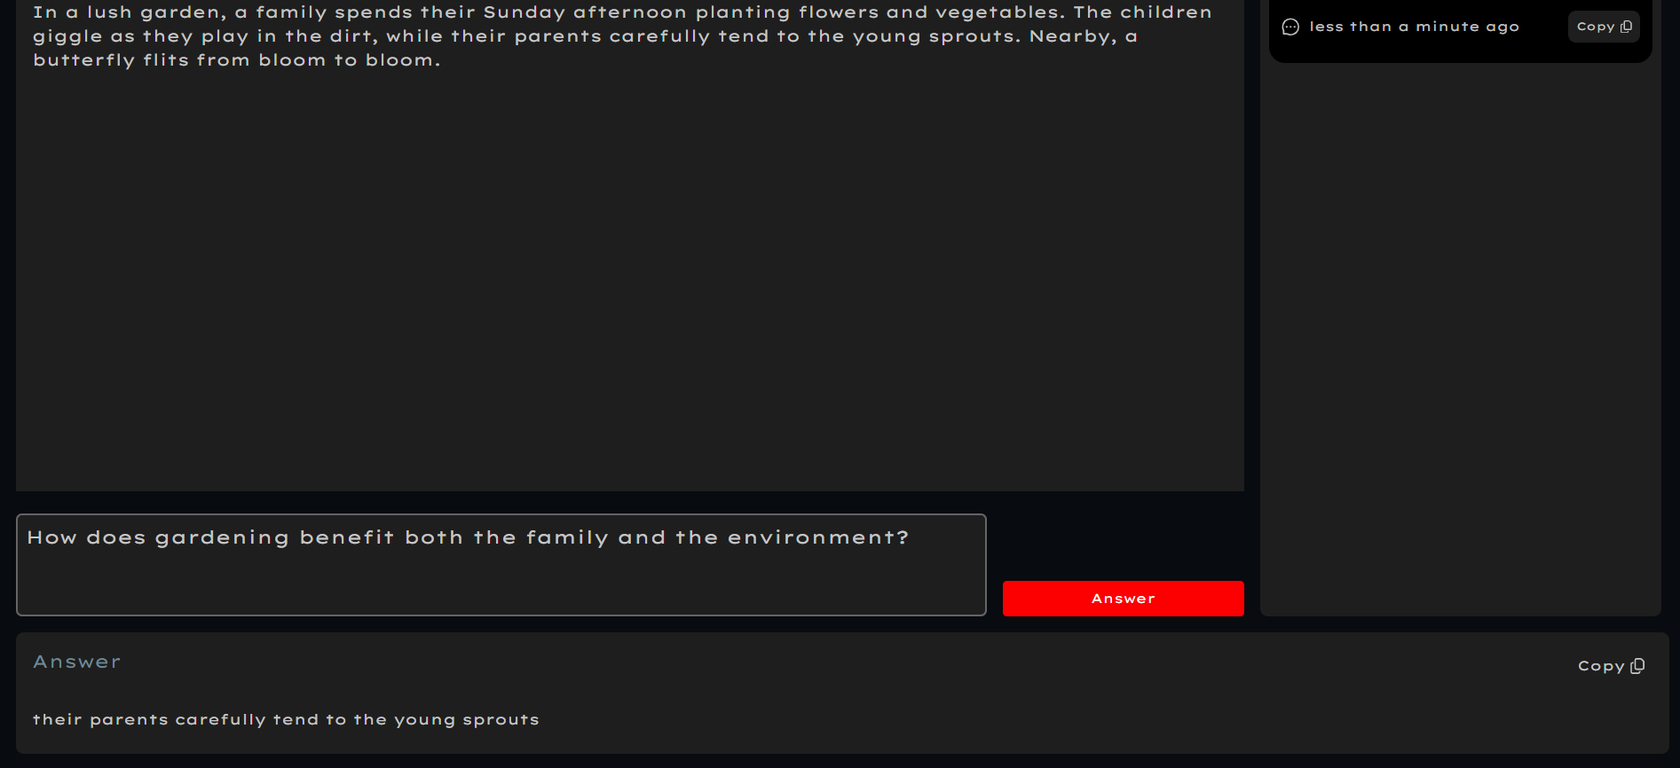
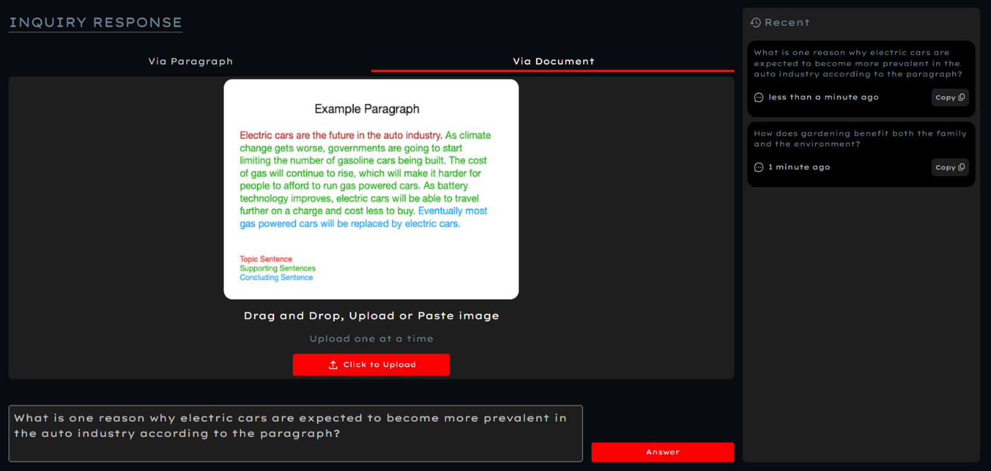
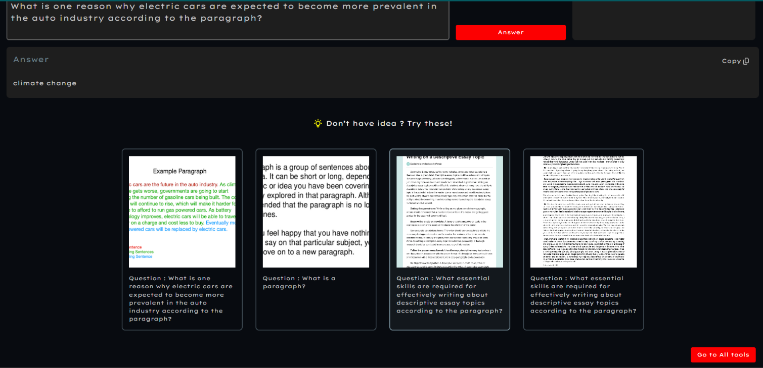

Slide 16
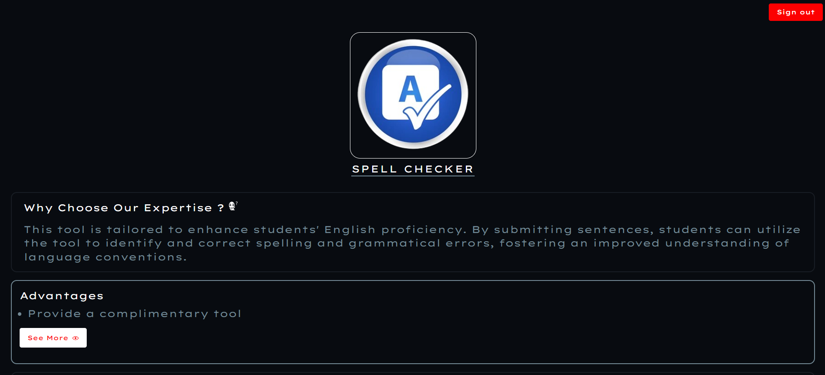
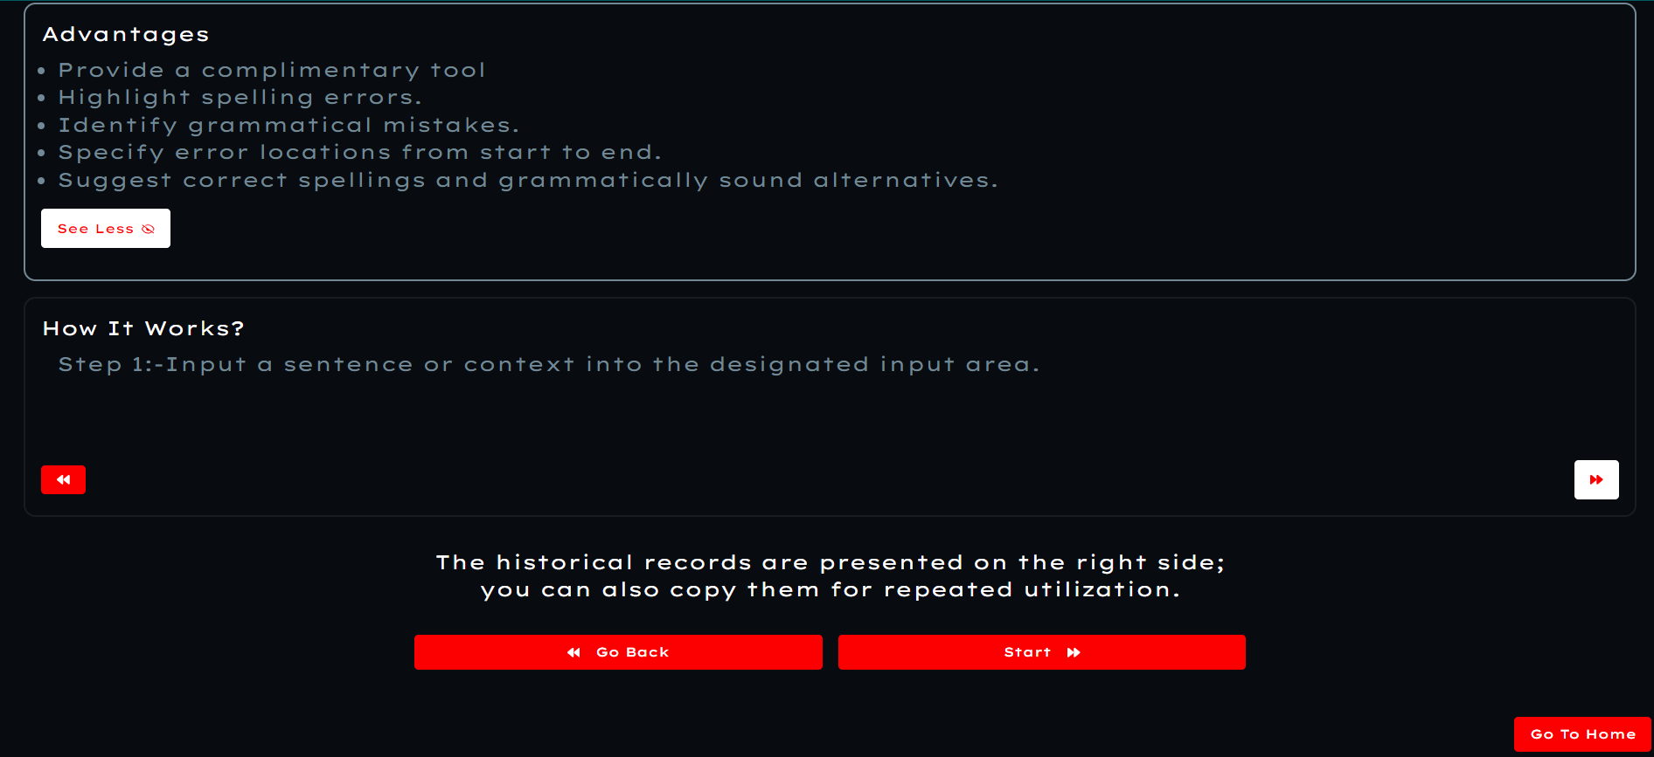
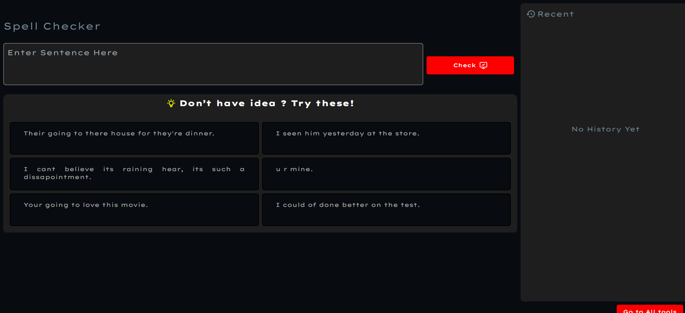
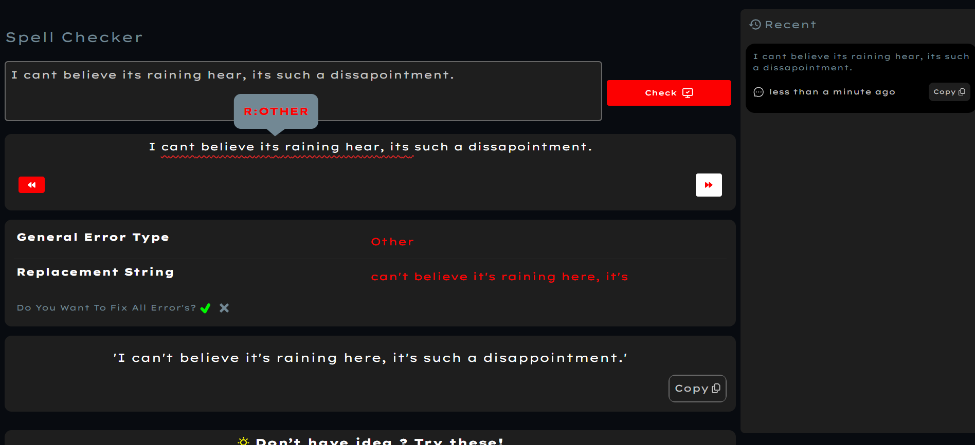
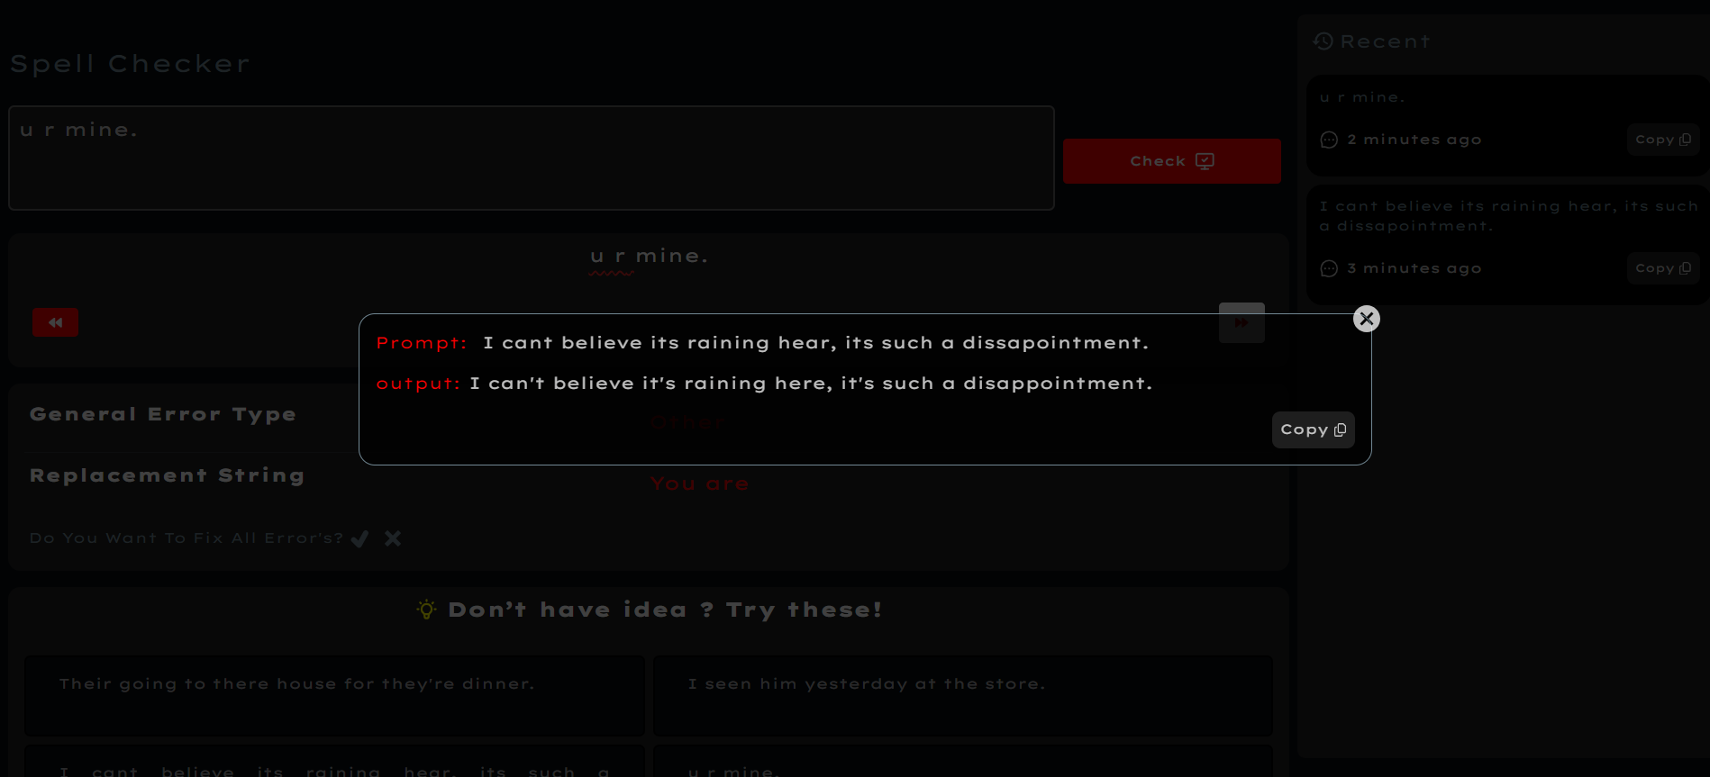

Slide 17
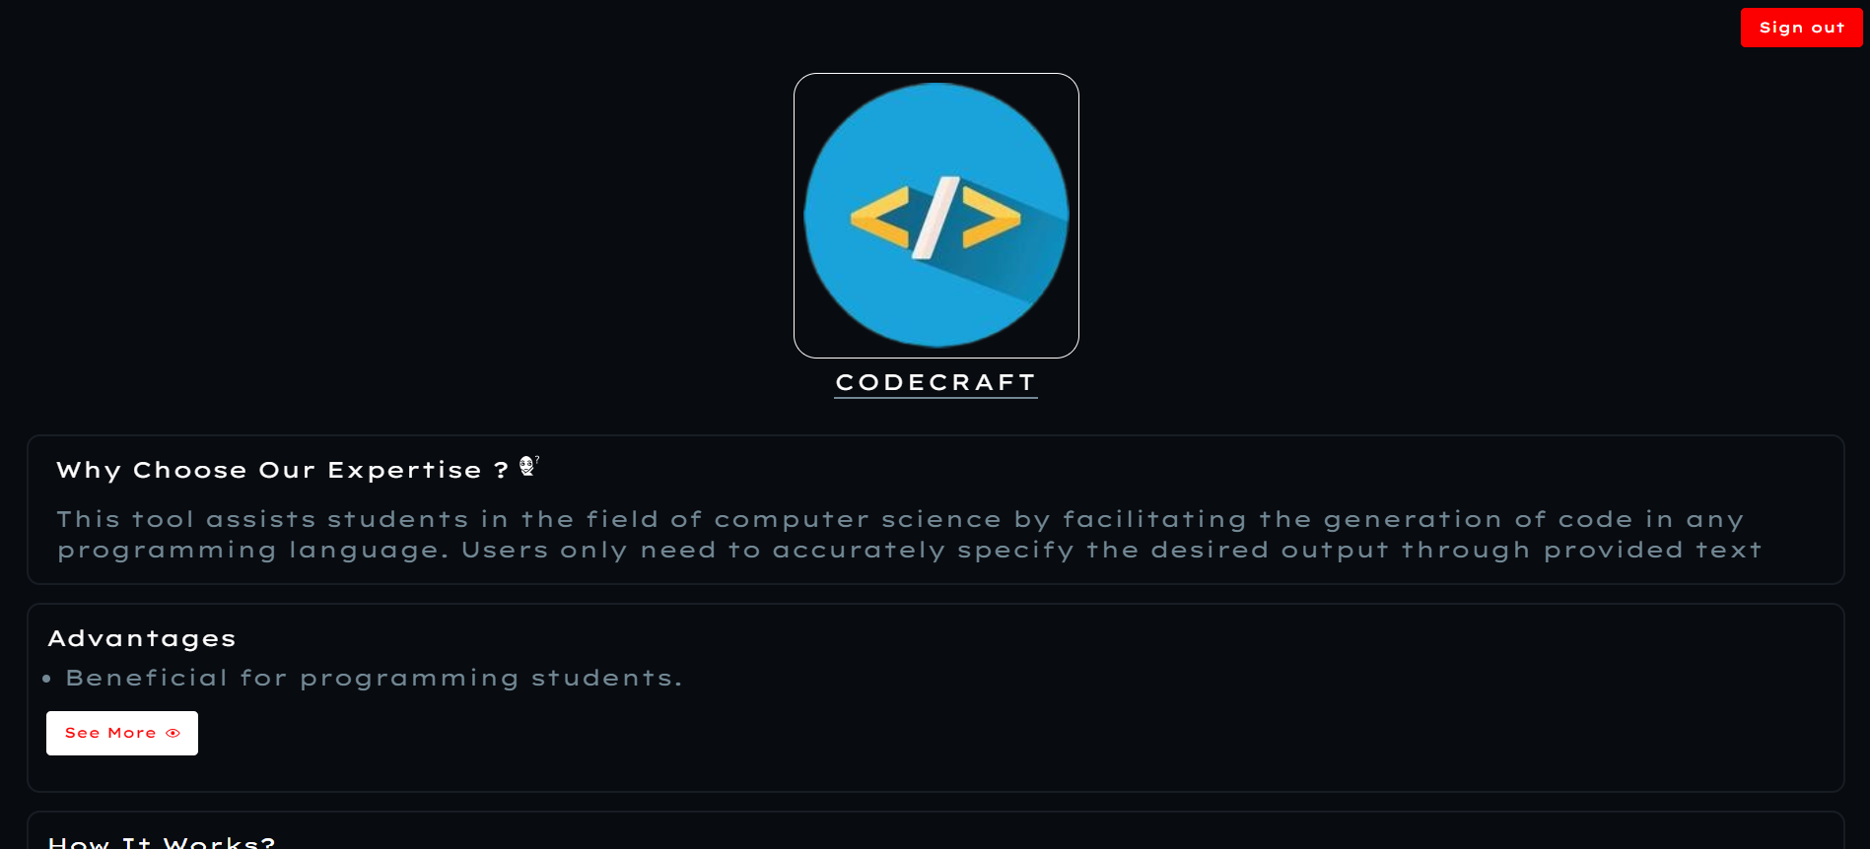
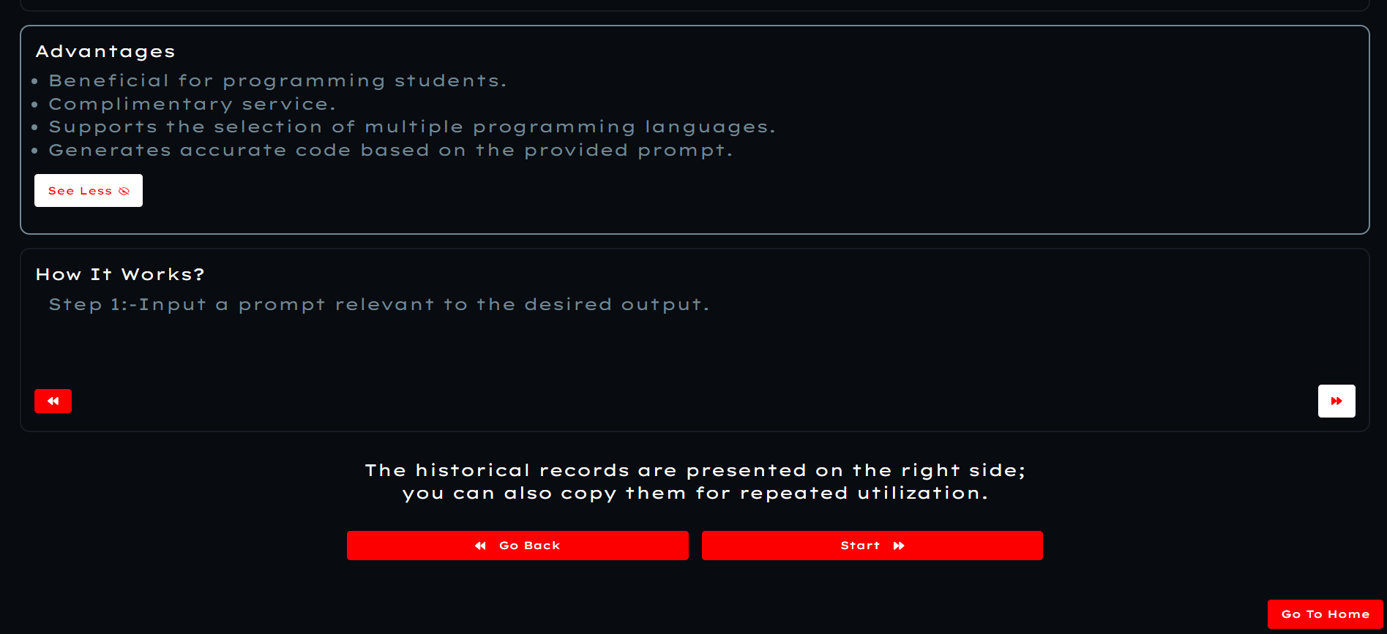
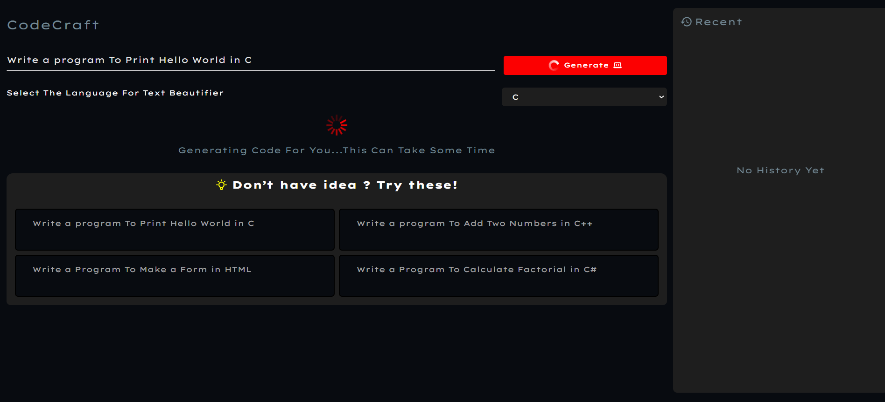



Slide 18






Slide 19







Slide 20






Slide 21





Slide 22








Slide 23
Future –Scope :
1
We have the potential to expand the array of AI tools in the future based on budget allocations and sponsor support. Presently a website, we aim to explore the feasibility of extending our services through a dedicated mobile application in the future.
2
3
4
5
6
7
8
9

Slide 24
Conclusion :
The purpose of the project is to provide a user-friendly integrated platform for students with all the required tools for their educational as well as professional purposes. And that’s the main reason why one must use our platform for their required needs.

Slide 25
THANK YOU!!!

